Slide 1
1.1 PowerPoint Deck Template Outlining Key ECE Advocacy Messages

Slide 2

A Roadmap For Achieving Universal Quality
Pre-primary Education By 2030
Notes:
Overall intent of this slide:
Key talking points:
First-ever comprehensive report on pre-primary education
Focus not only the status of pre primary education globally but also on outlining a series of key policy recommendations and actions that can make universal pre primary education a reality for every child by 2030
Report tackles three key themes of: (1) equity in access; (2) building systems to deliver quality; (3) financing

Slide 3

Global Commitment to
Quality Early Childhood Education
Target 4.2 By 2030, ensure that all girls and boys have access to quality early childhood development, care and preprimary education so that they are ready for primary education
Notes:
Overall intent of this slide: Set ECE in the context of SDG agenda and the commitments governments have made.
Key talking points:
The Sustainable Development Goals (SDGs), and target 4.2 specifically, convey a clear objective that all girls and boys have access to quality early childhood development, care and pre-primary education so that they are ready for primary education.
Providing all children with at least one year of quality pre-primary education is essential to achieve SDG 4.
Despite the global momentum, investment and actions by governments have been stagnant.
This is a pivotal moment to spur national and global efforts to increase the investment, political will and capacity needed to expand equitable access to quality pre-primary programmes.

Slide 4
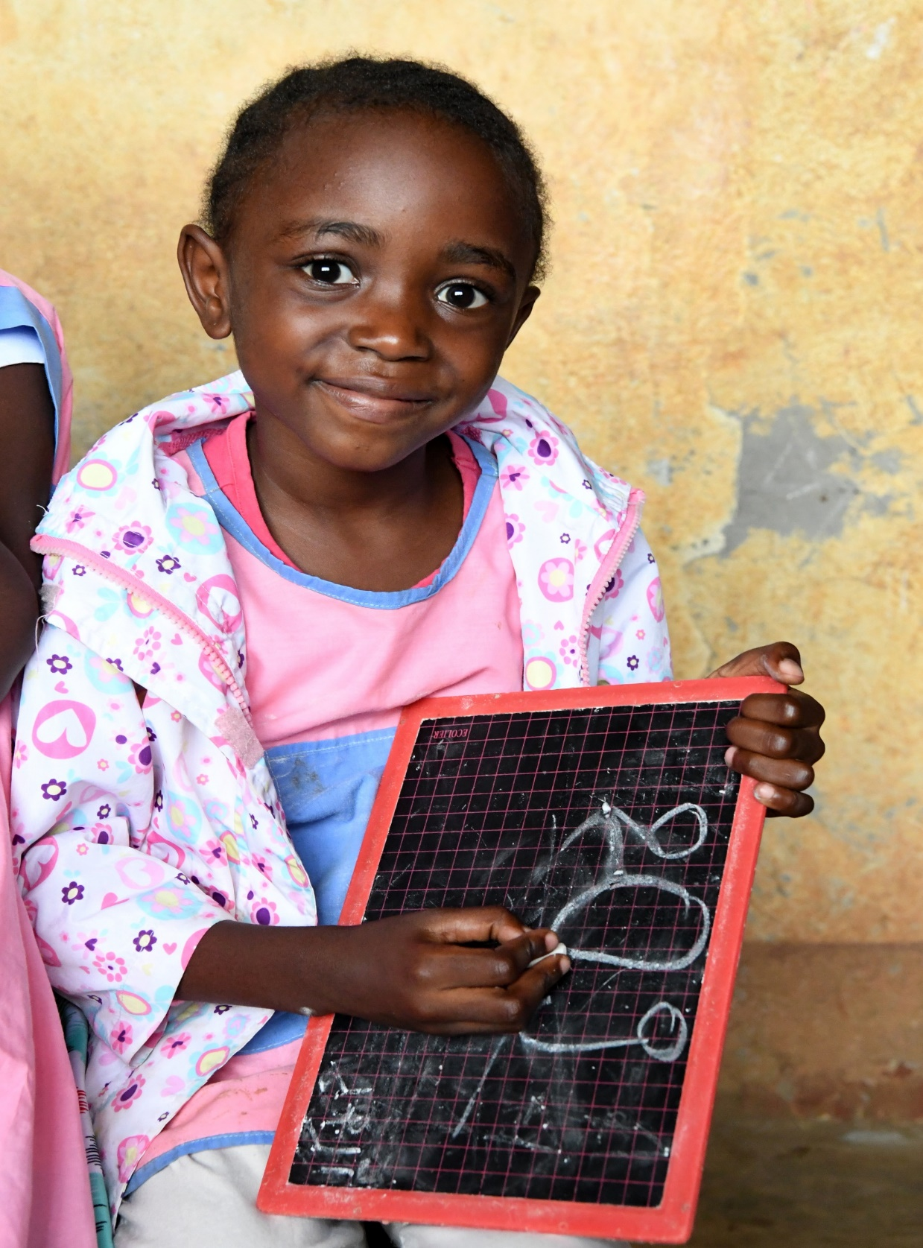

Why focus on universal pre-primary education?
Notes:
Overall intent of this slide:
Key talking points:
Quality pre-primary education is the foundation of a child’s journey: every stage of education that follows relies on its success.
Students equipped with a quality early childhood education are better prepared to reach higher levels of education and to prosper once they enter the workforce.
As adults, they are more able to contribute to peaceful and prosperous societies and economies.
Evidence of the ways in which pre-primary education advances development exists around the world.
Suggested additional points:
Early life experiences shape the architecture of the brain and lay the foundation for later development and inequities. Education is a key component of a child’s holistic development (encompassing health, nutrition, security and safety, responsive caregiving, early learning) in these early years.

Slide 5
Three vital reasons for making universal pre-primary education a global priority:
1
Quality pre-primary education sets a strong foundation for learning
2
Universal pre-primary education makes education systems more effective and efficient
3
Equitable pre-primary education is an effective strategy for promoting economic growth
Notes:
Overall intent of this slide: Outline the rationale for investing in quality ECE.
Key talking points:
Children who attend a quality preschool programme start primary school with a solid foundation for learning.
Children who have attended pre-primary education are more likely to enter school on time, less likely to drop out or repeat grades, and more likely to complete primary and secondary school.
The benefits of a quality pre-primary education support a country’s goals for economic growth. Quality ECE helps children grow into productive adults by providing a foundation for the skills that the modern job market demands (critical thinking, collaboration, communication, creativity, etc.).

Slide 6
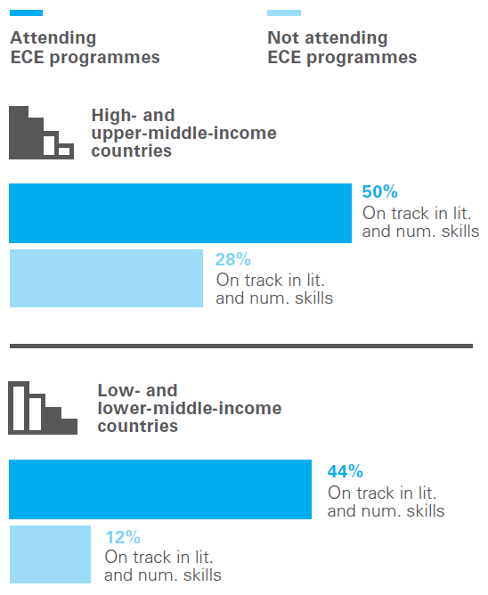
Attending an early childhood education programme is one of the strongest predictors for supporting a child’s readiness for school, regardless of household or national income level
Notes:
Overall intent of this slide: Demonstrate that ECE boosts children’s developmental outcomes and readiness for school.
Key talking points:
Children who attend a quality preschool programme start primary school with a solid foundation for learning – stronger social skills, larger vocabularies, better number sense and curiosity to learn more.
Higher national attendance rates in early childhood education programmes are linked to a significantly higher percentage of children who are developmentally on track both in overall development and in emergent literacy and numeracy skills specifically, regardless of their countries’ income status or overall levels of support for learning at home.
The difference in terms of development in emergent literacy and numeracy skills between children who attend ECE programmes and those who do not is much greater in low- and lower-middle-income countries than in upper-middle- and high-income countries. If we fail these children at the very start of their educational journey, how could we expect them to succeed?

Slide 7
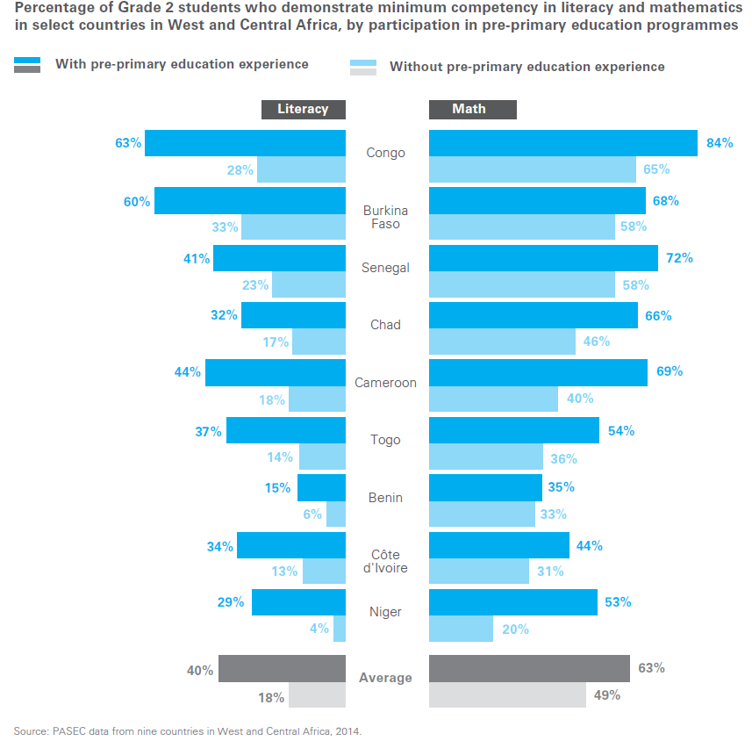
Pre-primary education advances successive learning achievements.
Note: Optional additional slide for Africa contexts
Notes:
Overall intent of this slide: Highlight that pre-primary education can lead to transformative gains in learning outcomes in early grades and later learning success.
Key talking points:
Analyses of regional assessment data from the Programme for the Analysis of Education Systems (PASEC)28 across nine countries from West and Central Africa indicate that children with any pre-primary experience were, on average, twice as likely to attain minimum competencies in literacy in Grade 2 (see Figure 1.3), and one and a half times more likely to have attained the minimum literacy competencies in Grade 6, compared to their peers without pre-primary.
[Note to presenter: Please feel free to discuss the country examples as relevant].

Slide 8
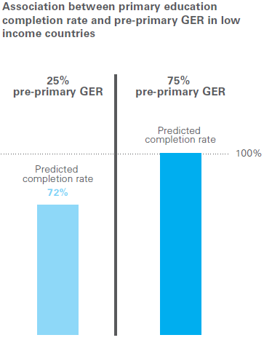
Universal pre-primary education helps make education systems more effective and efficient.
Notes:
Overall intent of this slide: Highlight that pre-primary education makes education systems more efficient and effective.
Key talking points:
Children who attend pre-primary education are less likely to repeat grades and to drop out.
Increasing access to pre-primary education could help significantly improve over-enrolment in low- and lower-middle- income countries and enhance system efficiency by decreasing dropout and repetition rates.

Slide 9
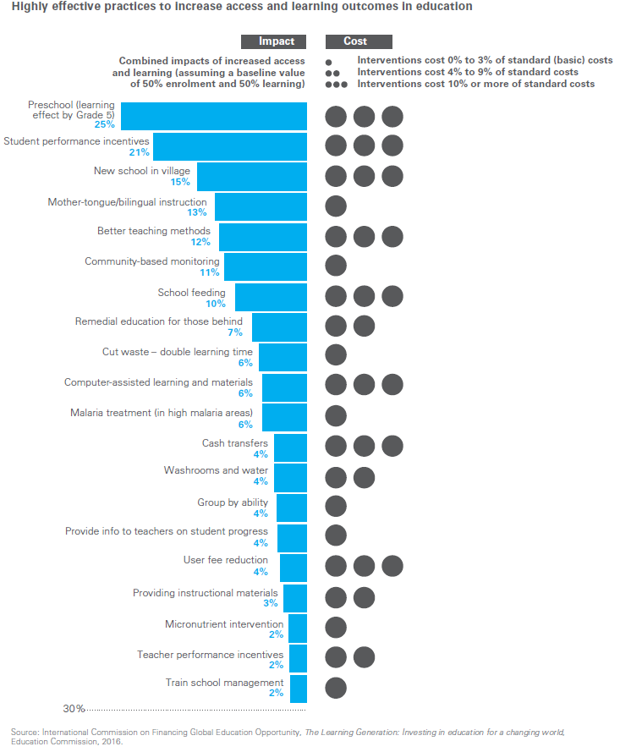
Universal pre-primary education is a powerful intervention to improve access and learning outcomes throughout primary schooling and into the secondary level.
Notes:
Overall intent of this slide: Show that pre-primary education as one of the most effective intervention to increase access and improve learning outcomes.
Key talking points:
1. It is clear that if pre-primary education were widely implemented, it could catalyse change and greatly improve education outcomes in developing countries.
2. Attendance in pre-primary education helps children persist in their schooling and reduces the costs needed to address poor results.
3. Increasing funds for pre-primary education should be viewed as a core strategy to strengthen the entire education system.

Slide 10
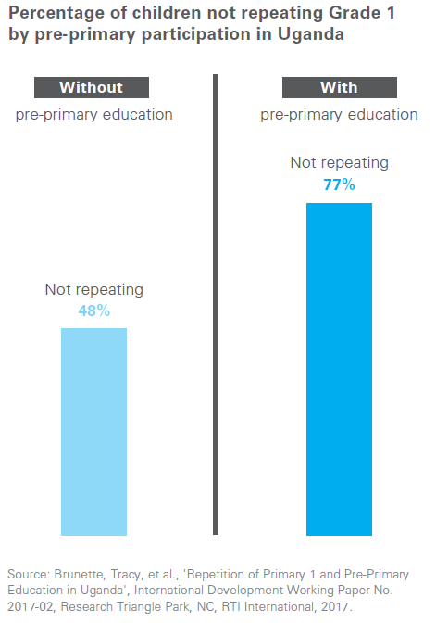
Increasing access to pre-primary education helps significantly improve over-enrolment in early grades and enhance system efficiency by decreasing dropout and repetition rates in primary school.
Note: Optional additional slide for East & South Africa Region
Notes:
Overall intent of this slide: Provide a country example (in ESAR context) of pre-primary education contributing to system efficiency through decrease in repetition rates.
Key talking points:
[Note to presenter: This slide is a relevant example for ESAR]
Uganda example: A recent pilot study found that children who did not attend pre-primary schooling were more than twice as likely to repeat Grade 1 at the primary-school level.
The protective effect of pre-primary attendance on repetition was the same for boys and girls.

Slide 11
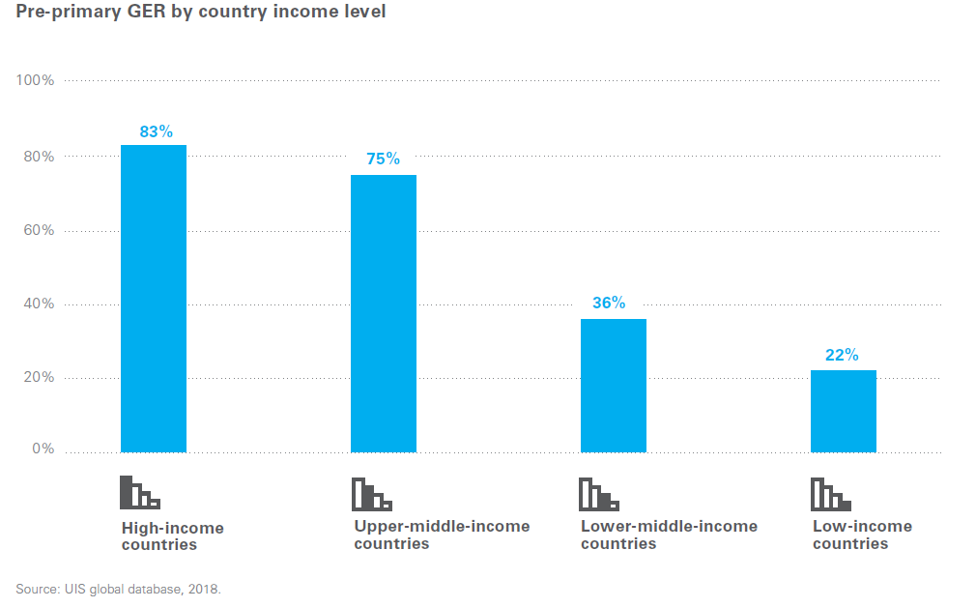
What is the current situation?
More than 175 million children – nearly half of the world’s pre-primary-age children – are not enrolled in pre-primary education
Notes:
Overall intent of this slide: Provide overview of current global situation on access to ECE (global and country income levels).
Key talking points:
More than 175 million children – around half of pre-primary-age children globally – are not enrolled in pre-primary education, missing a critical investment opportunity and suffering deep inequalities from the start.
In 2017, in low-income countries, 1 out of 5 pre-primary-aged children were enrolled in pre-primary education, compared to 4 in 5 in high-income countries.
This represents one of the greatest missed opportunities to cultivate the world’s human capital and help children reach their potential.

Slide 12
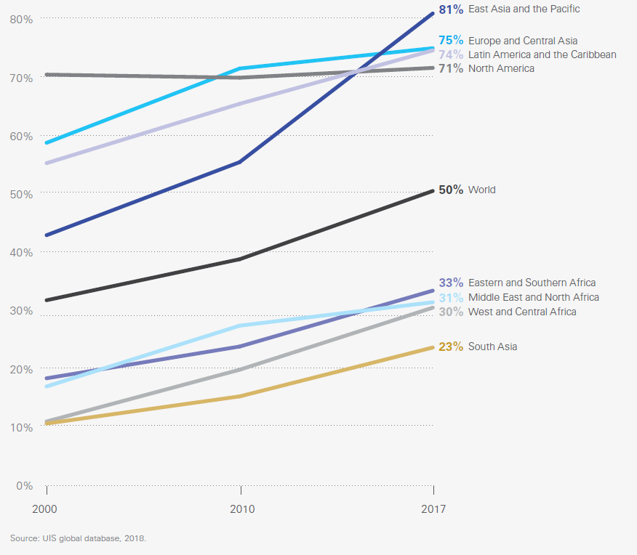
Global and regional trends in pre-primary GERs between 2000 and 2017
Note: Optional additional slide for all regions
Notes:
Overall intent of this slide: Show the progress globally and across regions in pre-primary GERs between 2000 and 2017.
Key talking points:
[Note to presenter: Please feel free to discuss as relevant for your region/country context].
All regions and income groups made progress in enrolment between 2000 and 2017, but the regions that were the furthest behind have made the smallest gains.

Slide 13
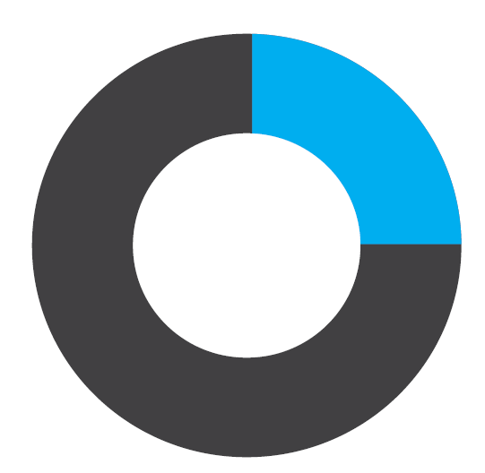
Note: Slide relevant for emergency contexts.
Countries affected by emergencies are home to nearly a quarter
of the world’s pre-primary-age children.
In those countries, only
1 in 3 children
are currently enrolled in
pre-primary education.
Notes:
Overall intent of this slide: Highlight the even more dire situation for children living in emergency contexts – many of them are denied access to early education opportunities.
Key talking points:
[Note to presenter: Please feel free to discuss this as relevant to your region/country context.]
UNICEF estimates that 23 per cent of pre-primary-age children worldwide (one in four) live in the 33 countries affected by emergencies – representing nearly 82 million pre-primary-age children who are affected by instability and at risk of toxic stress.
These are the children for whom pre-primary education opportunities can have some of the biggest and most lasting benefits. But the average GER in the countries affected by emergencies or crisis is only 31 per cent, much lower than the global GER of 50 per cent.

Slide 14
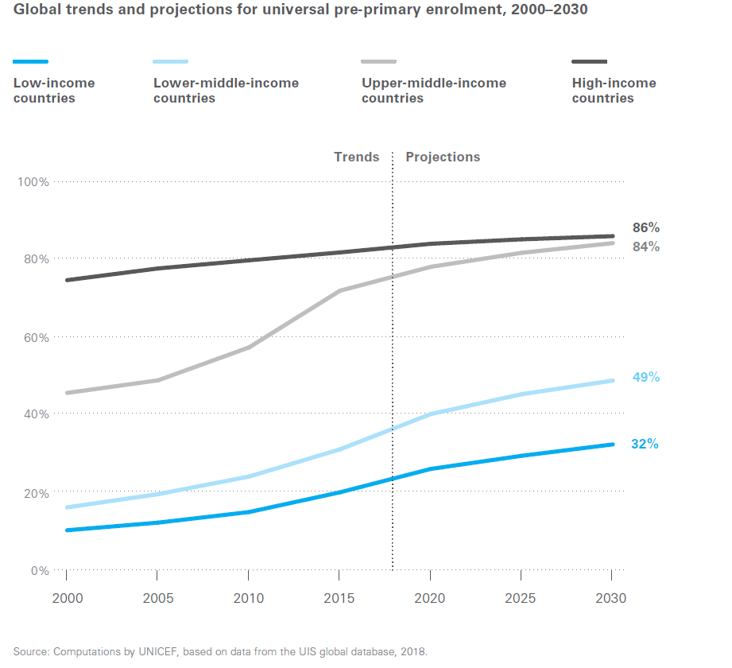
At the current pace, many low- and lower-middle-income countries will not achieve the SDG target for universal pre-primary education.
Notes:
Overall intent of this slide: Highlight the urgency to accelerate efforts to provide universal access to pre-primary education, particularly for low- and lower-middle-income countries.
Key talking points:
At the current pace of progress, GERs in pre-primary education in low-income countries will average only 32 per cent in 2030, compared to an estimated 86 per cent in high-income countries.
More than half of low- and lower-middle-income countries will not achieve the SDG target of universal pre-primary education by 2030. Many upper-middle- and high-income countries also remain behind and will likewise need to accelerate efforts in this subsector.
These gaps in access to pre-primary education are significant and the need to accelerate efforts is massive.
A ‘business as usual’ approach will not fulfil the promise of universal pre-primary education. The focus on pre-primary education must be intensified – especially in countries that are not on track to meet the universal target. Governments and the global education community should move decisively, now, to achieve universal access to pre-primary education by 2030.

Slide 15
A ‘business as usual’ approach will not fulfil the promise of universal pre-primary education…
To address the massive gaps in access the focus on pre-primary education must be intensified- especially in countries that are not on track to meet the universal target.
Governments and the global education community should move decisively, now, to achieve universal access to pre-primary education by 2030.
Notes:
Overall intent of this slide: Call to action for accelerating results for ECE.
Key talking points:
A ‘business as usual’ approach will not fulfil the promise of universal pre-primary education.
The focus on pre-primary education must be intensified – especially in countries that are not on track to meet the universal target. Governments and the global education community should move decisively, now, to achieve universal access to pre-primary education by 2030.
Governments and the global education community should move decisively, now, to achieve universal access to pre-primary education by 2030.

Slide 16
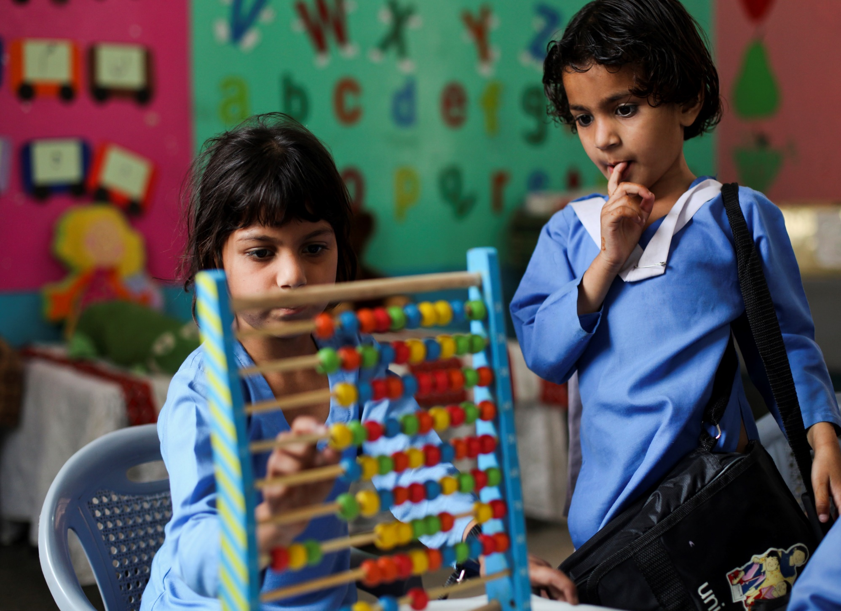

Challenges to equity, pathways to overcome them
Notes:
Overall intent of this slide: Introduce the first theme/challenge of equitable access to pre-primary education
Key talking points:
Pre-primary education offers an exceptionally powerful opportunity to break intergenerational cycles of inequity.
Half of the world's pre-primary age children are not enrolled in any type of pre-primary education; many of them live in low- and lower-middle-income countries.
Across 64 countries, the poorest children are seven times less likely than children from the wealthiest families to attend early childhood education programmes. For some countries, the rich-poor divide is even more apparent.
Securing universal access to quality pre-primary education requires bold measures that benefit disadvantaged children at least as much as their better-off peers, during every step of the process.

Slide 17
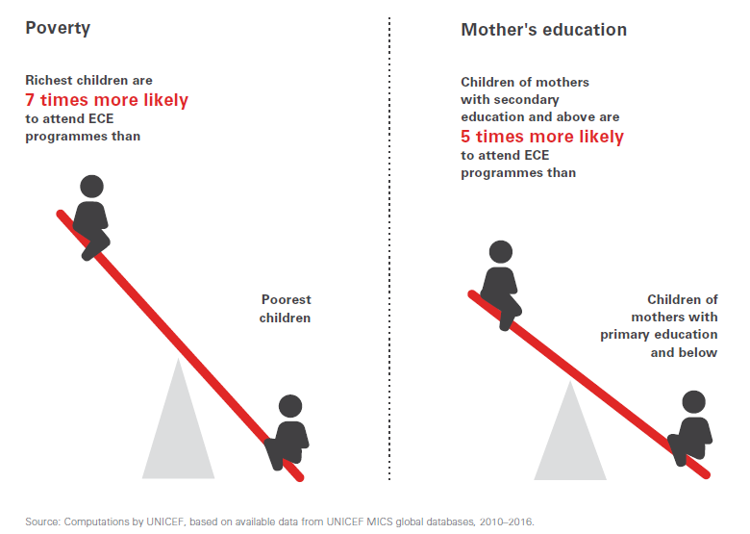
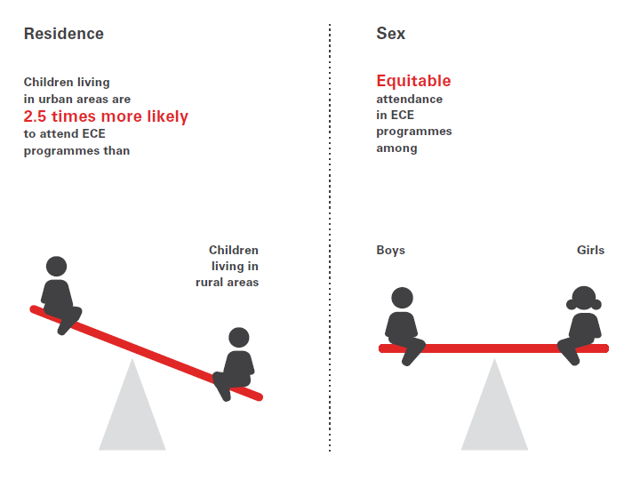
Key equity dimensions in Ensuring access
Notes:
Overall intent of this slide: Highlight the barriers to access to quality ECE – vulnerable children are disproportionately excluded from quality pre-primary education.
Key talking points:
The challenges of inequity are present in most countries and across most regions.
Globally, the most common barriers to a child’s participation in pre-primary education are household wealth and mother’s level of education. Notably, girls and boys generally achieve parity in attending early childhood education programmes.
Household wealth is the biggest determinant of attendance in ECE. In low-income countries, the richest children are eight times more likely to attend early childhood education programmes. But even in middle- and high-income countries, children from rich households are four times more likely to attend an early childhood education programme.

Slide 18
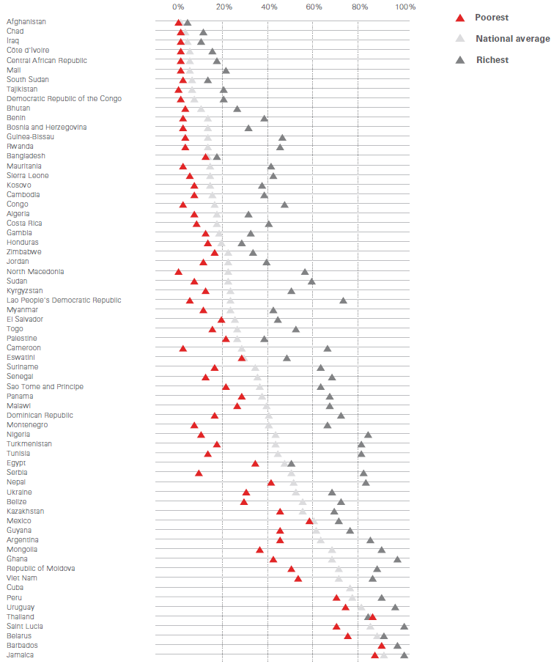
The strongest universal factor affecting access to pre-primary education is whether a child lives in a poor or a rich household.
Notes:
Overall intent of this slide: Show the impact of household income on children’s attendance in ECE.
Key talking points:
Household income is the strongest factor affecting access to ECE.
The figure shows the percentage of 3- and 4-year-olds attending ECE programmes by level of wealth (poorest and richest quintiles) in a selection of countries with available data. The stark difference between poor and rich children’s attendance is evident in nearly all countries, with poorest children disproportionately missing out.
On average, across 64 countries, the richest children are 7 times more likely than children from the poorest families to attend early childhood education programmes. In low-income countries, the richest children are 8 times more likely to attend early childhood education programmes. But even in middle- and high-income countries, children from rich households are 4 times more likely to attend an early childhood education programme
[Note to presenter: Please feel free to highlight a few country examples from the figure as relevant]

Slide 19
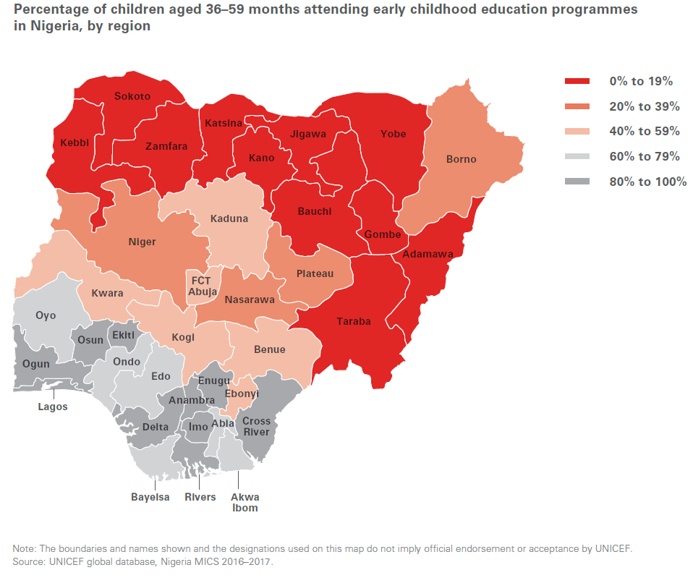
Subnational differences in early education attendance
Note: Optional additional slide for Africa
Notes:
Overall intent of this slide: Illustrate that within countries, access to pre-primary education varies across regions and districts – often linked to central-level decisions such as where to build preschools or how to recruit teachers.
Key talking points:
[Note to presenter: Please feel free to discuss as relevant to your region/country context].
National attendance rates in early childhood education may hide substantial differences within a country.
In Nigeria, according to the most recent MICS data (2016), northern states such as Bauchi and Kebbi report less than 10 per cent attendance in early childhood education – and only 4.4 per cent and 4.6 per cent of children attend early childhood education programmes in Yobe and Sokoto, respectively. Participation among children who live in the southern-most states, however, was on average never less than 70 per cent, and reached a high of 91 per cent in Imo.

Slide 20
THE IMPACT OF INDIVIDUAL-LEVEL FACTORS: Ethnicity, language and disability
Children from minority ethnic groups often attend early education programmes at lower rates than their peers in the same country.
The disadvantages that accompany minority status may be exacerbated when the language of learning and teaching is not a child’s primary language. This is a particular challenge for refugee and migrant children.
An analysis of disability data from 49 countries found that in every country children with disabilities were more likely to be out of school than their non-disabled peers.
Children from marginalized groups often experience reduced access to pre-primary programmes, in part because their communities may be stigmatized or may not have the political or social standing to demand services.
Notes:
Overall intent of this slide: Highlight individual-level factors that impact on inequities in access to ECE.
Key talking points:
Data are not as widely available across the individual dimensions.
Children from minority ethnic groups often attend early education programmes at lower rates than their peers in the same country.
The disadvantages that accompany minority status may be exacerbated when the language of learning and teaching is not a child’s primary language. This is a particular challenge for refugee and migrant children.
Inclusive early childhood education programmes are vitally important for children with disabilities. They can help mitigate the effect of disabilities and allow children to better integrate into the education system and society, and to become productive individuals. Participation in preprimary education can contribute to earlier identification of their needs and provision of support to both children and their families; it can also enhance the effects of early interventions for children with disabilities.

Slide 21
Bold and achievable measures are needed to address inequities:
Provide a minimum one-year package of quality pre-primary education for all children first, including through alternative and targeted programmes to reach difficult-to-reach children, and gradually expand the number of years included in this package, as the pre-primary system grows
Notes:
Overall intent of this slide: The road to universal access to PPE requires bold measures, consistent with an “equity first” approach.
Key talking points:
Countries have 2 paths to consider:
ambitious goals of 3 or more years of pre-primary education; small group of children benefits (often privileged subset of families) and expand to reach marginalized children; or
Minimum 1 year package for all children first to reach marginalized children; gradually expand number of years as pre-primary system grows.
The second option is consistent with a ‘progressive universalism’ approach outlined by the Education Commission in 2016: Disadvantaged children must gain at least as much as their better-off peers at each step of the process in order for universal pre-primary education to be achievable.

Slide 22
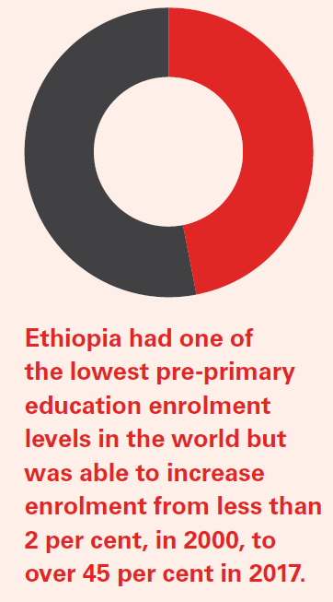
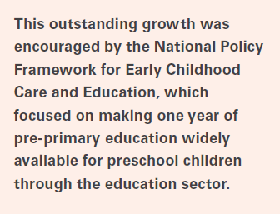
Country Example: Ethiopia
Note: Optional additional slide for Africa
Notes:
Overall intent of this slide: Provide an example of how a country accelerated access to ECE.
Key talking points:
Ethiopia, which had one of the lowest pre-primary education enrolment rates in the early 2000s, was able to substantially expand its pre-primary education subsector, from 1.6 per cent in 2000 to 45.9 per cent in 2017, and enrolment continues to grow.
The first significant growth in Ethiopia’s pre-primary enrolment came in 2010, with development of the National Policy Framework for Early Childhood Care and Education. This pro-poor policy represented a government commitment to support the growth of a more equal society and took two important steps towards expansion: it established a clear role for the Ministry of Education in leading and coordinating access to preschool education, and it established a specific focus on school readiness and preschool education within the education sector.
Starting out with a plan to provide two years of pre-primary education for children 4–6 years of age, the national policy and implementation plan instead re-focused on a single year of pre-primary (known as a 0 class), recognizing that a two year programme was not feasible in the short term. These 0 classes are now one of the most widely available options for preschool children and the highest priority for government, boosting enrolment rates even in rural areas.
Adopting a clear and highly targeted approach focused on the first year before the start of primary school allowed the Government and development partners to explore innovative ways to enhance access and at the same time begin to put in place a system to ensure quality and national capacity.

Slide 23
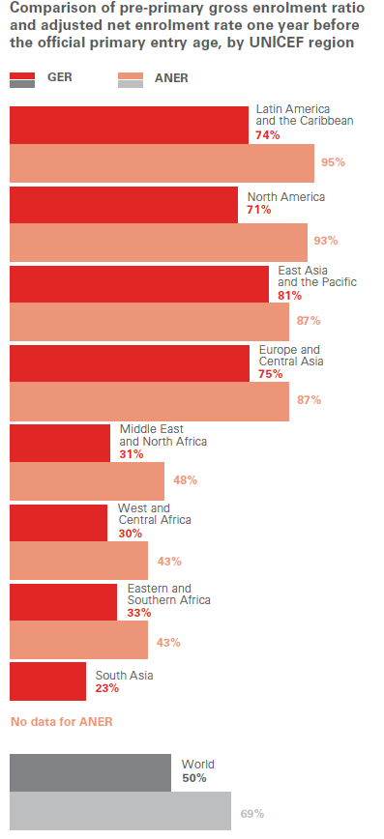
Universal, equitable coverage for the last year of pre-primary is within reach for several regions and much closer to realization for all regions than the overall target of pre-primary education for multiple years.
Notes:
Overall intent of this slide: Propose one possible way of improving equity in access to ECE – focusing on one year of pre-primary that is available to all children first.
Key talking points:
The most recent data show that, for the majority of countries, the adjusted net enrolment rate (ANER) for one year before the primary entry age is higher than the GER for multiple pre-primary years. Approximately 69 per cent of the world’s children were enrolled in the last year of pre-primary education, compared to a GER of 50 per cent for pre-primary as a whole. All regions are somewhat closer to universal last-year pre-primary attendance than they are to universal preprimary as a whole.
This shows that universal, equitable coverage for the last year of pre-primary is within reach for several regions and much closer to realization for all regions than the overall target of pre-primary education for multiple years.
This is one way of improving equity in access and growing systems and capacity gradually to expand to more years

Slide 24
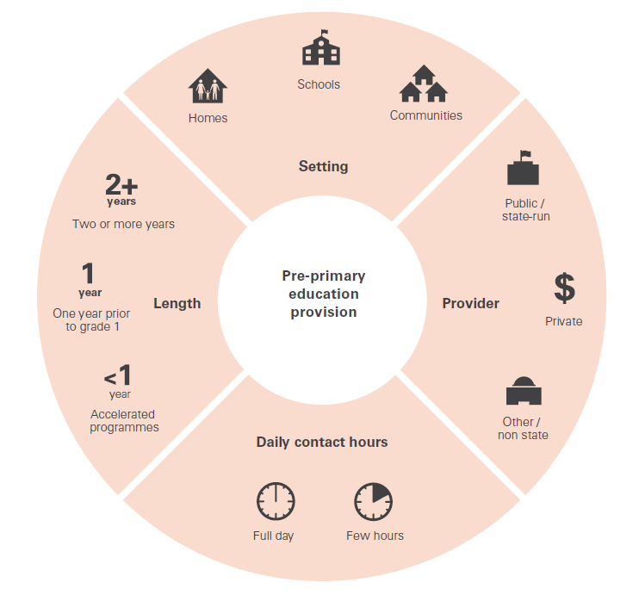
The public pre-primary model should be complemented by additional programme approaches (alternative and context specific) to make the universal target achievable.
Notes:
Overall intent of this slide: Public provision alone will not be sufficient to reach all children –the complex landscape of ECE provision should be leveraged to complement public provision through diverse programmes and modalities
Key talking points:
Equitable access means that we are catering to the needs and circumstances of all families and children. More than one programming approach might therefore be needed.
Luckily, the early childhood education landscape in most countries is diverse, with multiple programme models often implemented by various service providers – public, private and non-state, faith-based, community-based – with a wide-range of modalities.
The complexity of provision of early childhood education presents a tremendous opportunity to leverage diverse programmes and models to arrive at an expansion strategy that could make pre-primary education universal.
Complementing the public pre-primary model with additional programme approaches will make the universal target achievable.

Slide 25
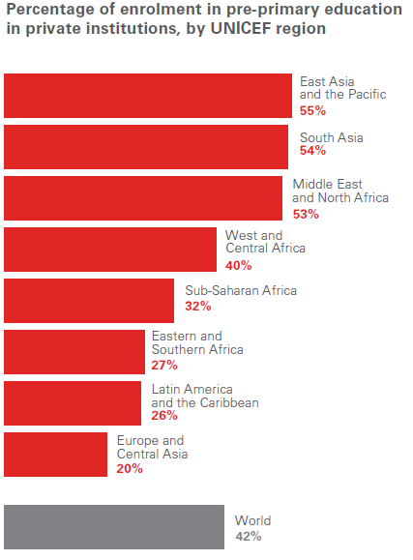
An “equity first” approach requires education systems to mobilize a wide range of partners, including the private sector.
Notes:
Overall intent of this slide: Coordination between government, civil society and private provision of pre-primary education is critical to reach universal target – leveraging existing providers (particularly the large proportion of private providers) in countries with low enrolment rates is a viable strategy for expansion.
Key talking points:
At the global level, private provision accounts for more than 40 per cent of pre-primary enrolment, compared to only 16 per cent in the primary subsector.
In low-income countries, 33 per cent of enrolment in pre-primary education is private; in lower-middle-income countries, 46 per cent of enrolment is in privately provided services.
It is very clear that this level of engagement of the private sector in pre-primary education warrants attention from ministries of education and should play a role in expansion efforts, along with efforts by civil society, for which data are limited but which have historically been the ‘movers and shakers’ in this subsector.

Slide 26
Recommendations: progressive universal access
Note: Please select the relevant recommendations for your region/country context/audience.
1. Demonstrate leadership and commitment. High-level political leadership and commitment to public pre-primary education are necessary on the on the part of governments. Education sector plans should establish clear priorities to support pre-primary education.
2. Put in place policies committing to universal pre-primary education and prioritize the poorest and hardest to reach at the start of the road to universality, not at the end.
3. Prioritize the implementation of a single year of universal free pre-primary education, with an aim to expand this provision to more years as the capacity of the pre-primary system grows.
4. Foster the development of flexible approaches in support of the children who are most vulnerable to exclusion from traditional public or private programmes.
5. Promote effective partnerships between governments, private and non-state providers of pre-primary education, maximizing early learning opportunities for children.
6. Improve the availability and reliability of routine data for preprimary education through national monitoring systems. Better data can support more equitable planning for the subsector.
Notes:
Overall intent of this slide: Recommendations
Key talking points:
[Note to presenter: Please select the key recommendations that are relevant for your region/country context/audience]
Additional talking points:
ECE is a critical component of broader ECD, which requires cross sectoral coordination across sectors (in health, nutrition, child protection, water, sanitation and hygiene, etc.). Coordination with other sectors will strengthens the efficacy of education outcomes as well as other brain development related interventions.
The education system is critical for linking with other sectors’ platforms. For example, incorporating parent engagement into existing healthcare systems, integrating nutrition and health curricula into pre-primary education programs.

Slide 27

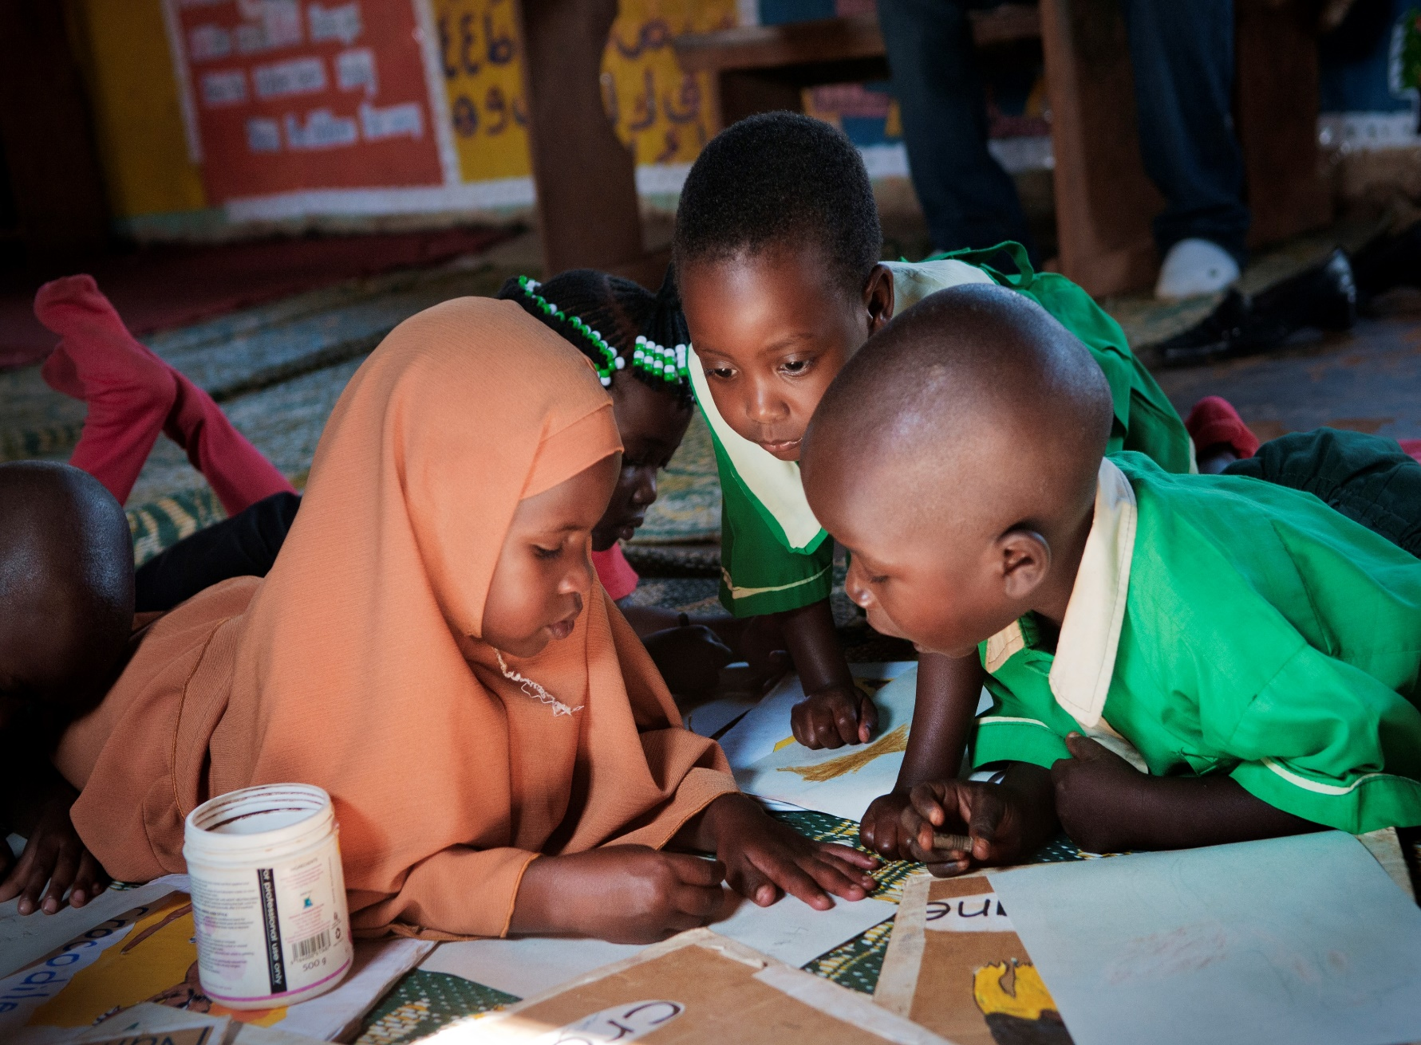
Building pre-primary systems to deliver quality at scale
Notes:
Overall intent of this slide: Introduce the second theme/challenge of quality ECE at scale
Key talking points:
Quality and access must always be linked. All children need to have access to pre-primary education, but low-quality programmes depress demand, waste resources and do little to close the learning gap for disadvantaged children.
How can pre-primary education systems progressively reach all children and improve quality at the same time? → Quality universal pre-primary education requires a systems approach, with pre-primary education recognized and supported on a similar basis to other education subsectors.
Governments will need to navigate trade-offs (given the limited amount of human and financial resources) as they expand access to pre-primary education.

Slide 28
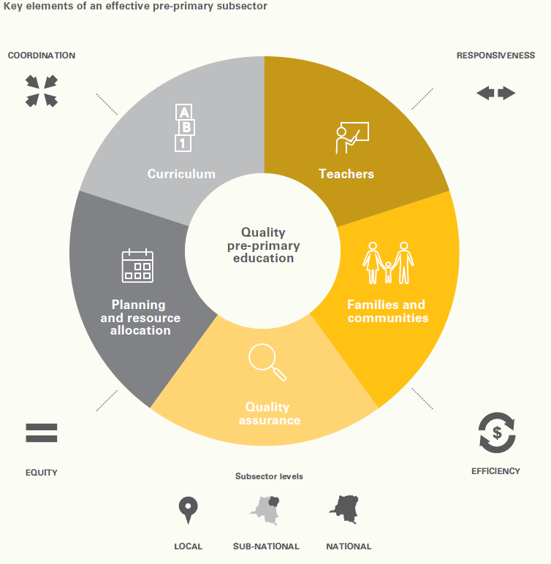
Quality universal pre-primary education requires a systems approach.
Notes:
Overall intent of this slide: Introduce the conceptual framework for effective pre-primary education systems – systems-strengthening approach that considers the core functions (as a whole) of the pre-primary subsector.
Key talking points:
Quality can be conceptualized as culminating in the day-to-day experiences and interactions that have the most immediate influence on children. Fundamentally, quality in pre-primary education is measured by how well the learning environment supports children in gaining the knowledge and skills that will enable them to develop intellectually, physically, socially and emotionally.
Quality is not a stand-alone entity of education for young children, but the sum of many interlinked components, including teachers, families and communities, quality assurance, planning and use of resources, and a curriculum designed to help children learn and grow to their full potential.
Building this system can deliver quality programmes at scale, but no single component will lead to quality education if the others are under-resourced or neglected.

Slide 29
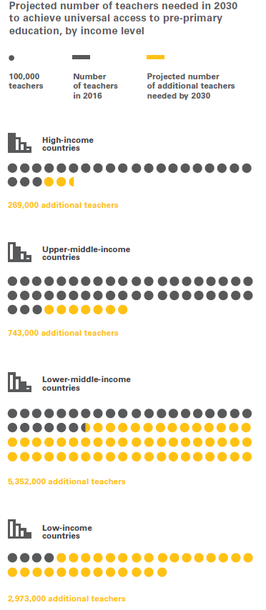
Navigating key challenges:
Globally, the supply of pre-primary teachers will need to double by 2030 to meet the SDG target of universal coverage with an ideal pupil-teacher ratio of 20 to 1.
This means over 9 million new early childhood educators will be needed across countries.
Notes:
Overall intent of this slide: Teachers are at the heart of quality – one of the key challenges with ensuring quality in the universal pre-primary agenda is the massive shortage of pre-primary teachers.
Key talking points:
One of the greatest challenges developing countries face is the need to staff the pre-primary subsector with teachers who can nurture a love of learning in young children. Qualified teachers are already in short supply, and yet a massive increase in their numbers is required as countries look to fulfil the promise of universal pre-primary education.
While there are more than 9 million pre-primary teachers globally, only 422,000 of them work in low-income countries. In 2016, nearly 17 per cent of the world’s pre-primary-age children lived in low-income countries but only 4 per cent of the world’s pre-primary teachers.
Assuming a PTR of 20 to 1,19 the world will need 9.3 million new teachers to meet the universal target for pre-primary education by 2030. Nearly 90 per cent of these teachers will be needed in low- and lower-middle-income countries.

Slide 30
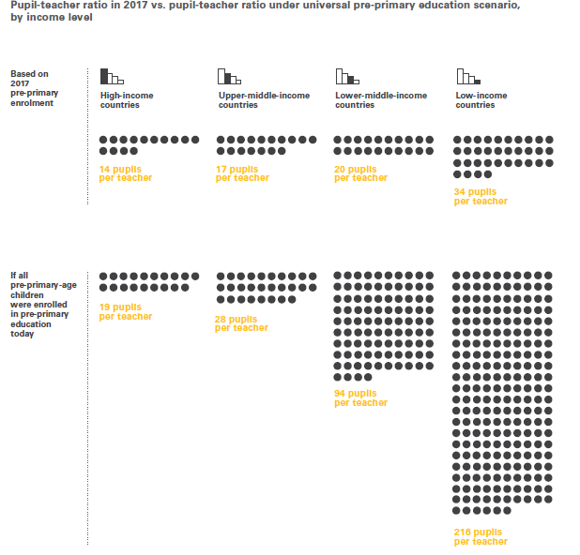
Notes:
Overall intent of this slide: PTRs are a factor in the quality of the teaching and learning experience in early childhood. If all pre-primary-age children were in preschool today, the PTRs in lower-middle- and low-income countries are exponentially higher, exemplifying the substantial lack of teachers.
Key talking points:
Smaller PTRs and group sizes are a key predictor of child outcomes in the early years and support positive relationships between staff and children in centres for children of age 3–6 in most research studies conducted.
The pupil-teacher ratio (PTR) is significantly lower among high-income (14 to 1), upper-middle-income (17 to 1) and lower-middle-income countries (20 to 1) than in low-income countries, where it averaged 34 to 1 in 2017.
Many countries show a lower average ratio, but those numbers are misleading because so few children have access to pre-primary services in those countries.
A more realistic indicator of the pre-primary education workforce challenge can be shown by estimating the PTR under universal coverage of pre-primary education – that is the total number of pre-primary-age children in a country against the number of pre-primary teachers currently in the system. The average ratio of pre-primary-age children to teachers in low-income countries in 2017 then increases to 216 to 1.

Slide 31
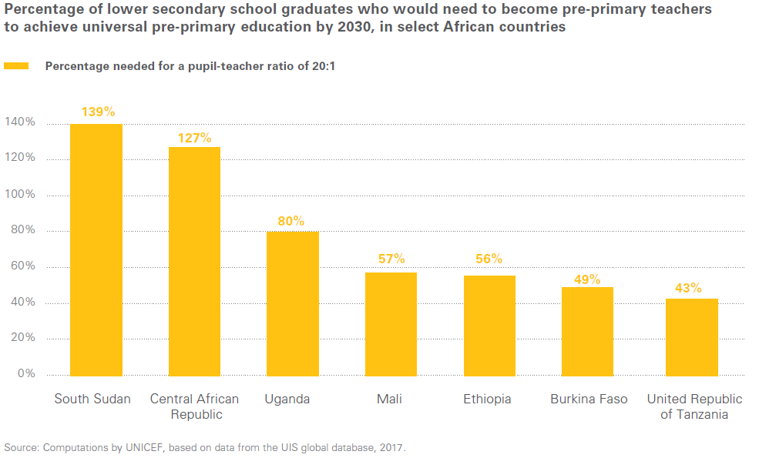
Note: Optional additional slide for Africa contexts.
Notes:
Overall intent of this slide: Illustrate the scale of the problem (lack of teachers) and the unrealistically fast progress needed to achieve universal access with highly educated teachers and adequate PTRs.
Key talking points:
[Note to presenter: Please discuss these examples as relevant.]
Many countries in Sub-Saharan Africa face a dilemma with respect to teacher qualifications and PTRs.
Example of Uganda: Uganda has set high school completion as its pre-primary teaching requirement, but to meet the projected demand, 80 per cent of its lower secondary school graduates would need to become pre-primary teachers if universal access and a PTR of 20 to 1 were to be achieved.
Other examples: South Sudan currently has 3,200 pre-primary teachers and would need about 66,000 more by 2030 to meet the universal target. Even if every one of South Sudan’s lower secondary school graduates in a single year were to become a pre-primary teacher, this would still not be enough to meet the goals of a PTR of 20 to 1 and universal access – and the same is true for the Central African Republic and Chad.

Slide 32

In low-income countries, in 2017, only 50 per cent of pre-primary teachers had received training, compared to 74 per cent at the primary level.
Notes:
Overall intent of this slide: In addition to recruiting and training new teachers, many of those who are already in the system need opportunities to enhance their skills.
Key talking points:
In low-income countries, in 2017, only 50 per cent of pre-primary teachers had received training, compared to 74 per cent at the primary level.
The data show the scale of the unrealistically fast progress needed to achieve universal access with highly educated teachers and adequate PTRs.
Expansion will have to be gradual, well planned and ideally accompanied by a gradual increase in the number of lower secondary school graduates.
An interim strategy is needed: recruiting teachers who initially may lack academic qualifications or formal training but possess the nurturing qualities required to provide a positive learning experience for children. These teachers must be provided with intensive training and support.

Slide 33

It is only by investing in quality as the system grows – not before or after – that stakeholders can find a balance between expanding access and maintaining quality.
Notes:
Overall intent of this slide: To progressively achieve the 20 to 1 PTR target, most low-income governments will need to significantly increase their spending per child enrolled and meet key quality goals.
Key talking points:
Teachers are just one component of quality pre-primary education systems. Other quality inputs must be considered in budgeting decisions: learning and teaching materials, curriculum, teacher training, quality assurance mechanisms.
Greater investments in these quality inputs are therefore needed, such that a higher share of the budget is dedicated to non-salary items, like learning and teaching materials, teacher training, curriculum development and quality assurance mechanisms (25% of recurrent pre-primary expenditures be reserved for non-salary costs).
At the same time, all pre-primary educators (including those outside the public sector) should be given access to intensive teacher training and support mechanisms.
This sort of interim strategy ensures that education professionals will become increasingly skilled over time as a result of both formal training and experience on the job.
To compensate for the lack of qualified teachers with high academic qualifications and specialized degrees, ministries of education can expand the workforce by initially lowering qualification requirements and dedicating more funds to intensive training and support for teachers.
Greater investments in quality assurance and teaching and learning materials would be needed, resulting in a higher share dedicated to non-salary items.
when a higher
percentage of the pre-primary budget is allocated to nonsalary
expenses, the possibility is created to give better
support and training to teachers, but the trade-off is that
teachers’ salaries would need to be lower.
Budgeting and ensuring quality inputs

Slide 34

14 of 34 countries have not specified a standard related to the PTR. Even when a PTR standard exists, compliance with this standard varies.
Notes:
Overall intent of this slide: Building or rebuilding the pre-primary sector is not an overnight transformation. Quality assurance will need to be established in a progressive manner, with capacity built across the system gradually within the vision for a holistic quality framework.
Key talking points:
All pre-primary education systems need the capacity to monitor the quality of programmes, and ideally the outcomes for children, and to provide ongoing opportunities for training and other forms of support to educators and service providers.
A well-functioning pre-primary subsector has a quality assurance system that supports greater equity and ensures consistent quality in service delivery. There are typically 3 aspects covered by such systems: development of clear and consistent standards; design of a monitoring or regulatory mechanism; and data analysis for ongoing improvement, including regular feedback loops to pre-primary institutions.
While global data on quality standards and quality monitoring in early childhood education are not readily available, SABER data indicate that quality assurance is widely neglected or under-resourced. Most countries do not have the capacity to monitor and enforce adherence to standards.
Strong accountability means that quality assurance frameworks need to be backed up by implementation capacity across different levels of government. Working to fill these capacity gaps as the system grows is of paramount importance.

Slide 35
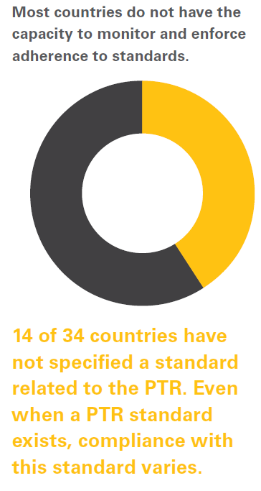
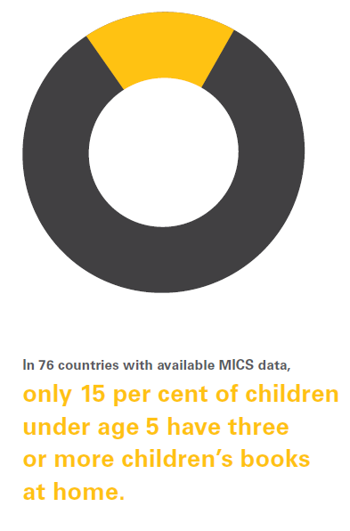
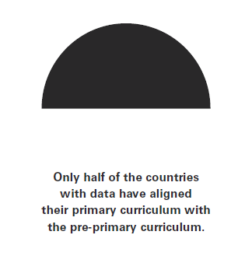
OTHER QUALITY ASPECTS
Notes:
Overall intent of this slide: Highlight data relating to other aspects of quality.
Key talking points:
Quality standards and regulatory mechanisms must be established and their implementation prioritized. Strong accountability means that quality assurance frameworks need to be backed up by implementation capacity across different levels of government. Working to fill these capacity gaps as the system grows is of paramount importance.
Implementing a developmentally appropriate and child-centred/play-based curriculum is vital. A well-designed curriculum will reflect a child-centred, inclusive approach, promoting emergent language, literacy, numeracy and social-emotional development, and it will provide enough flexibility to respond to local contexts and languages, reflecting children’s life experiences while encouraging innovation.
Effective pre-primary systems should engage and support families and communities. Engaging with families as partners is a vital element of increasing demand for universal access and quality of services as well as for ensuring a continuum of learning between home and school over time.

Slide 36
Recommendations:
WIN-WIN SCENARIOS TO ADVANCE BOTH ACCESS AND QUALITY
Note: Please select the relevant recommendations for your region/country context/audience.
1. Develop strong implementation plans for the pre-primary subsector, to back up policy commitments. Solid investments in quality and capacity development are needed as the system grows, not after.
3. Implement clear quality standards for the subsector and put in place a functional framework for regular monitoring of pre-primary programmes across both public and non-state/private providers. Progressively lowering the PTR to no more than 20 children per teacher should be a key quality goal.
4. Dedicate at least 25 per cent of recurrent pre-primary budgets to non-salary expenditures, so that key quality investments, such as teacher training and on-the-job support, curriculum development, teaching and learning materials and quality assurance mechanisms, can be prioritized.
5. Strengthen the engagement with families as active participants in their children’s development and education so that they can drive the demand and mandate for quality early education programmes and improve the support for learning available at home.
6. Fortify curricular frameworks to ensure they reflect a child-centred, inclusive and holistic approach to learning and development, aligned with early grades. Ensure flexibility of curricular frameworks to respond to local contexts and encourage innovation and sharing across providers.
2. Develop robust strategies for growing and supporting the pre-primary workforce. In the short term, greater numbers of teachers with lower initial qualifications can be hired, compensating with intensive continuous professional development. A longer-term strategy for gradually upgrading teacher qualifications and retaining quality teachers should complement this approach.
Notes:
Overall intent of this slide: Recommendations
Key talking points:
[Note to presenter: Please select the key recommendations that are relevant for your region/country context/audience]

Slide 37


Significantly increase financing for pre-primary education
Notes:
Overall intent of this slide: Introduce the third theme/challenge of increasing financing for pre-primary education
Key talking points:
Pre-primary education is deeply underfunded relative to other education levels.
Shortfalls in domestic and international funding are impeding access to quality pre-primary education
At the most basic level, the issue is twofold: More funds are urgently needed, and it is crucial to determine how funds can be used most efficiently.

Slide 38
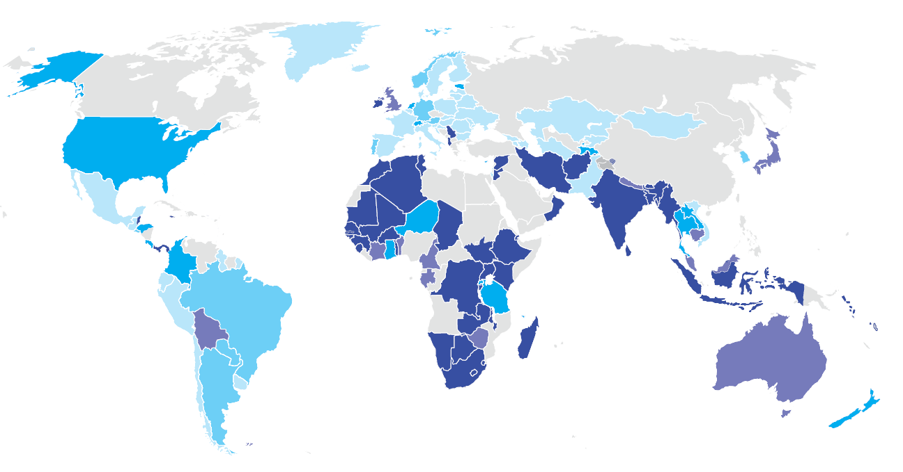
Expenditure on pre-primary education as a percentage of total government education expenditure across countries
Notes:
Overall intent of this slide: Present the global picture of domestic financing for pre-primary education.
Key talking points:
Domestic financing for pre-primary education is persistently low, inadequate and inequitable. In 2017, an average of 6.6 per cent of domestic education budgets globally were allocated to pre-primary education.
Globally, 38 per cent of countries invest less than 2 per cent of their education budgets in pre-primary education.
Low-income countries invest, on average, less than 2 per cent of their education budgets in pre-primary education, while high- and upper-middle-income countries allocate, on average, 9 per cent and 8 per cent, respectively.
Percentage of government education expenditure on pre-primary education by region:
EAPR: 5.3%
ESAR: 2.1%
ECAR: 11.3%
LACR: 8.1%
MENA: 1.6%
SA: 3.9%
WCAR: 2.5%

Slide 39
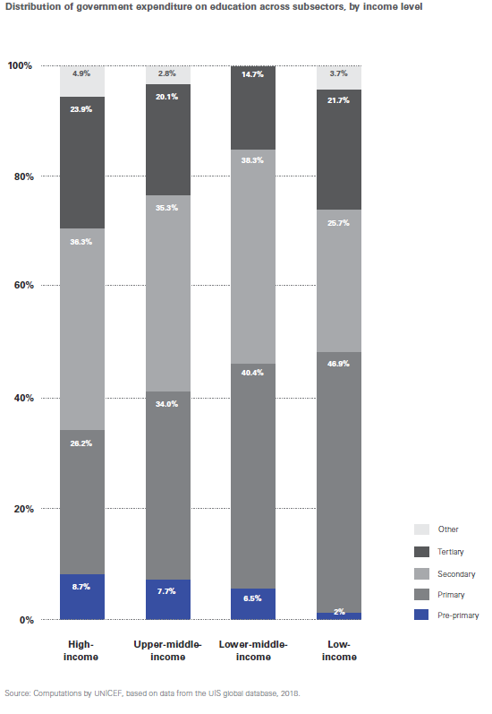
The distribution of funds across education levels is highly inequitable in low- and lower-middle-income countries.
Notes:
Overall intent of this slide: The current budgetary priorities of most governments fail to reflect the value of pre-primary education, which is often seen as being in competition for funding with other levels of education, instead of as a key strategy to strengthen results in other subsectors.
Key talking points:
Pre-primary education provides the highest return on investment of all education subsectors – it increases primary school intake, strengthens efficiency and improves learning. Yet, as a general pattern across country income levels, pre-primary education received a smaller share of the education budget than primary, secondary or tertiary education over the past 10 years.
In 2017, low-income countries on average spent nearly half of their education budget on primary education (46.9 per cent), followed by spending on secondary education (25.7 per cent) and post-secondary education (21.7 per cent). Only 1.95 per cent was spent on pre-primary education.

Slide 40
Fewer than 1 per cent of children in the poorest half of the population will reach higher education in many sub-Saharan African countries, yet all of these countries continue to spend far more on higher education than on pre-primary education.
Notes:
Overall intent of this slide: Example to highlight the inequitable distribution of funds across education levels.
Key talking points:
The trend of underinvesting in pre-primary education, relative to other subsectors, has been stable over time in low-income countries.

Slide 41
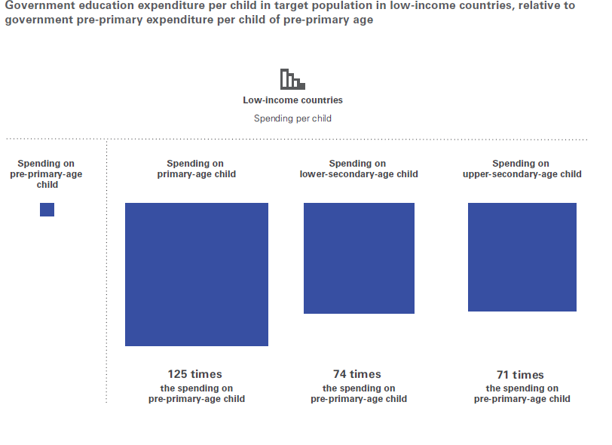
Notes:
Overall intent of this slide: Looking at how much of the education budget is spent on a level of education in comparison to the related population size (e.g., government pre-primary education spending in relation to the total number of pre-primary-age children in the population).
Key talking points:
An examination of education budgets in relation to target populations, as well as by education level, reveals the scale of the current underinvestment in ECE.
The average low-income country spends about 125 times more per child (enrolled and unenrolled) on primary education than on pre-primary education, and over 70 times more on lower and upper secondary education.
In contrast, high-income countries spend about 2 times more per child on primary education than on pre-primary education, and 3 times more on lower and upper secondary education.

Slide 42
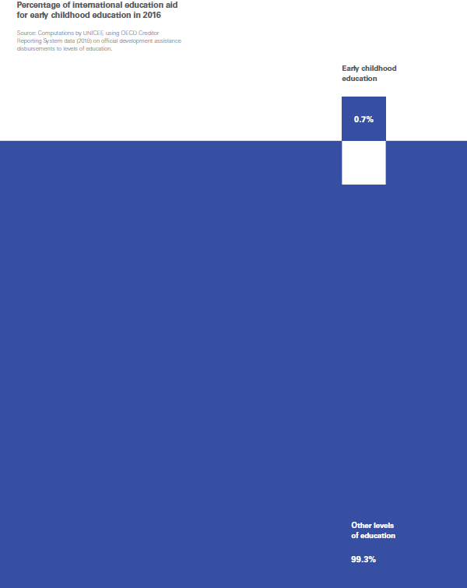
International aid to pre-primary education has been drastically lower than funding for any other level of education.
Less than 1 per cent
of international aid for
education is invested
in pre-primary education.
Notes:
Overall intent of this slide: External financing for pre-primary education is extremely limited.
Key talking points:
The availability of external financing is critical, especially for the poorest countries, which have the lowest enrolment rates, the greatest inequities and the largest funding gaps.
Donor aid to pre-primary education has been and continues to be drastically lower than aid for any other level of education.
Less than 1 per cent of international aid for education is invested in pre-primary education.
Additional points:
Despite the overwhelming evidence of the myriad benefits of education to individuals, families, and societies, education in emergencies (including ECE in emergencies) continues to be underfunded by both governments and humanitarian actors alike. https://archive.ineesite.org/en/education-financing
There is also a lack of prioritization of funding within education budgets dedicated to underserved populations, including refugees and internally displaced persons.

Slide 43
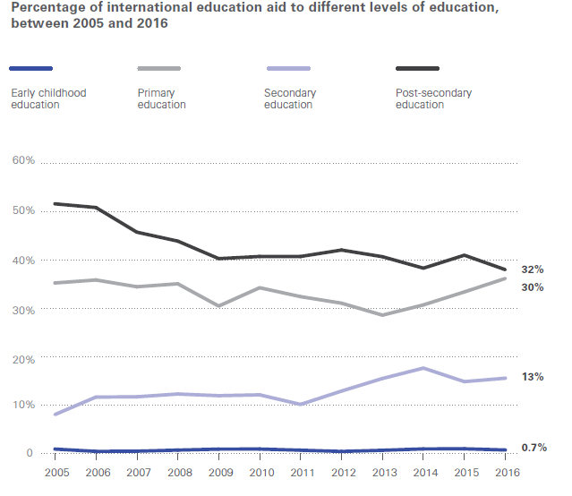
Note: Optional additional slide.
Notes:
Overall intent of this slide: Show the evolution of official development assistance to education between 2005 and 2016, by level of education.
Key talking points:
Aid disbursements reflect the same inequitable domestic patterns of resource allocation across education levels.
Post-secondary education, for example, received the highest percentage of international aid to education, followed by primary and then secondary schooling over the 10-year period between 2006 and 2016.
There was a decline in the share of funding given to post-secondary education, falling from 42 per cent in 2006 to 32 per cent in 2016. But this decline did not result in more funds for pre-primary education. Funding for secondary education, on the other hand, nearly doubled, from 7 per cent in 2005 to 13 per cent in 2016.

Slide 44
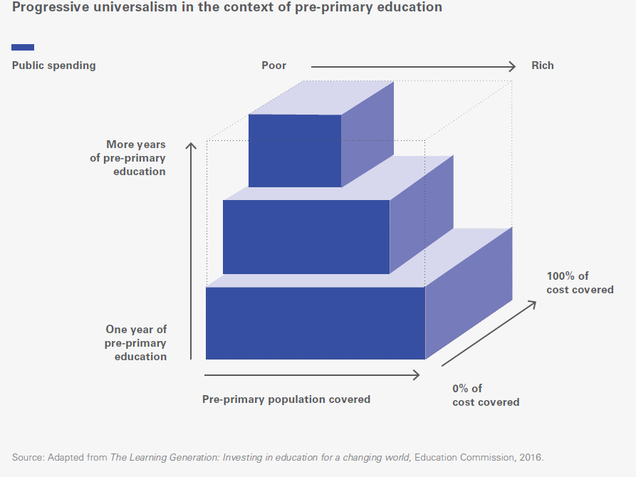
What would it take:
Use available resources more equitably and efficiently
Ensure vulnerable populations
are not the last to benefit
Notes:
Overall intent of this slide: Highlight the application of progressive universalism in the context of financing for pre-primary education.
Key talking points:
While it is essential for governments to boost pre-primary education budgets, it is just as important to consider how available resources are allocated and if they are used efficiently and equitably.
Translating the progressive universalist concept to the pre-primary education subsector:
governments should use limited public resources to provide a minimum one-year package of free quality pre-primary services for all children, including through alternative and targeted efforts to reach vulnerable children
subsequently, as more funding is made available, system capacity grows and the subsector can expand to additional years of pre-primary education, government priority should be to direct public resources first to disadvantaged children and ensure they are the ones benefiting first from extended services and additional years of preschooling.

Slide 45
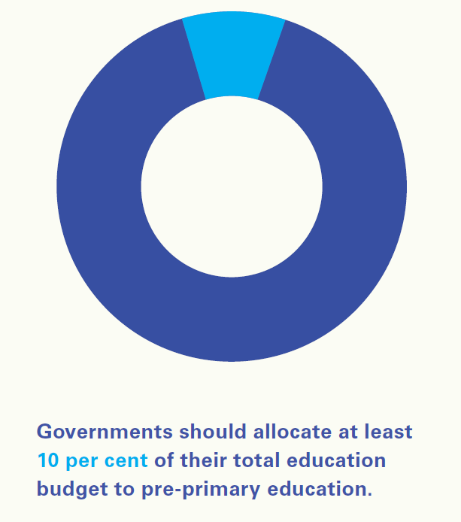
Notes:
Overall intent of this slide: Changing course to bolster pre-primary financing – placing pre-primary education on a firm financial footing by allocating 10% of education budgets to the subsector
Key talking points:
1. To ensure universal access, it is necessary for countries to:
integrate preschool services into existing financing for other core education services; and
boost domestic financing, including upper-middle- and high income countries.
2. In low- and lower-middle-income countries, maintaining the current spending on pre-primary education will not suffice to reach the target of universal access by 2030.
3. Securing adequate funding for universal quality pre-primary education will no doubt take place incrementally and progressively, but the aim of allocating at least 10 per cent of domestic education budgets to the pre-primary subsector (TheirWorld calls for this 10% as well https://theirworld.org/resources/detail/leaving-the-youngest-behind#section-3) must be clear from the start.

Slide 46
Recommendations: BUDGETING AND PLANNING FOR UNIVERSAL PRE-PRIMARY COVERAGE
Note: Please select the relevant recommendations for your region/country context/audience.
1. Place pre-primary education on as firm a footing financially as other education subsectors, by allocating at least 10 per cent of education budgets to it. Securing adequate funding will take place progressively but it requires that ministries of education and ministries of finance elevate the role of pre-primary education in the budgeting process.
2. Donors should lead by example, by allocating at least 10 per cent of their education investments to pre-primary education, catalysing and complementing public resources. In emergency contexts, donor support for pre-primary education should significantly increase and be prioritized in education sector aid.
3. Strengthen governance and accountability mechanisms between national and local governments, and invest in implementation capacities across the subsector in order to ensure the efficient allocation and use of preprimary resources at all levels of government.
5. Leverage the private sector, which plays a large and important role in delivering pre-primary education in low- and middle-income countries. Where capacity in public systems is stretched, it is important to partner with nonstate actors and collaborate to expand access to affordable quality services.
6. Commit to tracking and reporting expenditures on pre-primary education by both governments and donors. This will strengthen accountability, improve budgeting and planning, and pinpoint areas needing the most improvement, including efficiency, cost-effectiveness and financing gaps.
4. Use public resources to provide a minimum one-year package of free quality preprimary education for all; as additional years of preschool become possible, prioritize disadvantaged children. Allocate available public resources in an equitable way, by removing financial barriers to access for the most vulnerable children first.
Notes:
Overall intent of this slide:
Key talking points:
[Note to presenter: Please select the key recommendations that are relevant for your region/country context/audience]

Slide 47
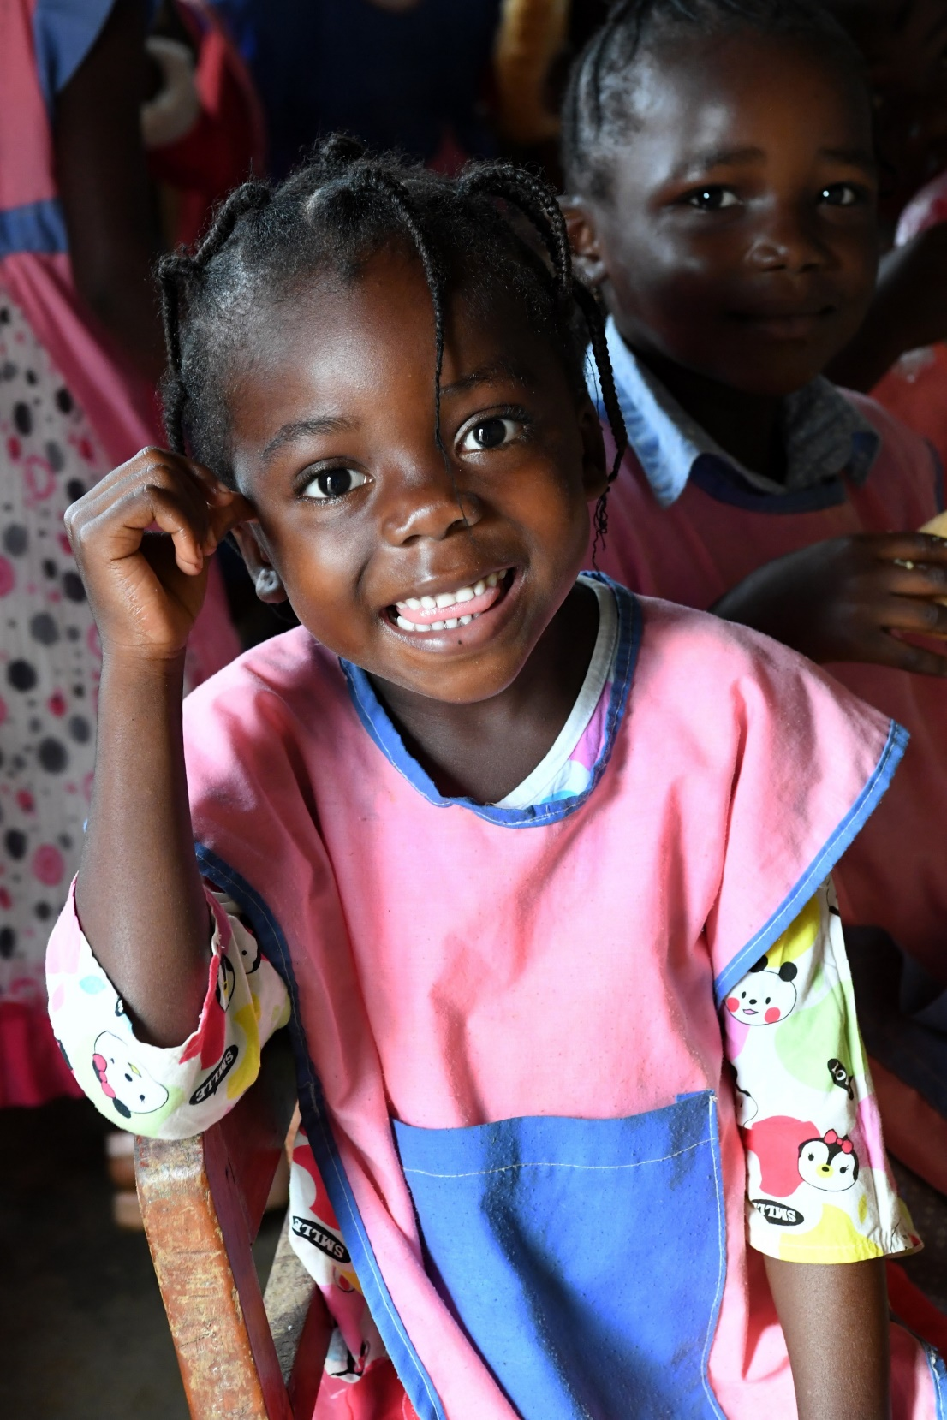
Pre-primary education for all: Immediate action, driven by a long-term vision
Notes:
Overall intent of this slide: Introduce the call to action
Key talking points:
Providing universal access to pre-primary education is a reachable target, but it requires a practical and bold approach that addresses present realities while also setting a long-term vision.
This is not a ‘last mile’ challenge: Many low- and lower-middle-income countries are still near the start of constructing or rebuilding the pre-primary component of their education systems.
Countries should pursue smart, proven strategies that can help them embark on the path towards quality universal pre-primary education. By setting policy priorities and navigating trade-offs, it is possible to build education systems that will place millions of children today on the path to fulfilling their potential.

Slide 48

Call to Action
There is an urgent need for leadership by Ministries of Education and Finance to make pre-primary education a routine part of every child’s education. To support their commitment, the following recommendations are proposed:
Prioritization of at least one year of pre-primary education in every country’s Education Sector Plan and policies.
Policies that maintain a universal commitment and prioritize the poorest and hardest-to-reach children (including children living in countries affected by emergencies) at the start of the road to universality, not at the end.
Commitment to build durable systems for early childhood education that can deliver quality at scale, including developing robust strategies for growing and supporting the pre-primary workforce and establishing quality standards.
Significant increase in financing for pre-primary education and ensure an adequate level of public and international resources for this subsector (at least 10% of education budgets allocated to this subsector.
Common vision for the subsector among governments, donors and partners to make funding and technical assistance available where and when it is most needed.
Notes:
Overall intent of this slide: Recommendations for making pre-primary education a routine part of every child’s education.
Key talking points: [Note to presenter: Please feel free to focus and/or expand on any of these as necessary.]
Pre-primary education must move from the margins of education sector plans to their centre. There are difficult short-term policy choices to be made to accelerate the trend lines, including the duration of pre-primary programmes and the reallocation of financing. But with strong political, technical and financial support, solutions are within reach for each of these challenges.
Pro-equity strategies have two elements in common: They recognize that current inequitable access widens the gap between the richest and the poorest children, and they start with careful consideration of why marginalized communities are not receiving services. Strategies include providing one year of pre-primary education everywhere before committing additional expenditures to add more years of pre-primary anywhere, providing complementary programmes in support of those who are most vulnerable to exclusion from traditional programming, and prioritizing low-income areas for teacher deployment, construction and renovation, as well as provision of materials.
Invest in quality as the system grows – not after – striking a balance between expanding access and maintaining quality so that pre-primary education results in real benefits for all children. Strengthen the governance and implementation capacity of the pre-primary system across all levels of government.
Governments should dedicate at least 10 per cent of their total education budget to pre-primary education. Donors should lead by example, by making the same commitment and allocating at least 10 per cent of their education investments to this subsector, including in humanitarian crisis, catalysing and complementing public resources and filling in short-term gaps. Expanded access cannot come at the expense of diminished quality. Therefore, governments should commit at least 25 per cent of recurrent pre-primary budgets for non-salary expenditures such as training for teachers, curriculum development, teaching and learning materials and quality assurance mechanisms.
Reaching the target of universal pre-primary education will take a broad coalition of partners supporting multiple service providers – including public, private and non-profit providers such as religious and civil society organizations. Parents are likewise vital partners in raising the demand for reaching the goal. Domestic and international partners are key to infusing investments in this fledgling subsector, providing flexible resources to fill the gaps that domestic financing alone cannot address. Capacity-building, training and other technical support will be key, with a commitment to work with local institutions and ensure the transfer of capacities to a stable pre-primary subsector.

Slide 49
Pre-primary education must move from the margins of education sector plans to their centre. There are difficult short-term policy choices to be made to accelerate the trend lines – but with strong political, technical and financial support, solutions are within reach for each of the challenges.
Notes:
Armed with these recommendations – and the evidence to back them up – governments and partners around the world can build the foundations that will ensure that universal quality pre-primary education services reach all children, including the most vulnerable.
This can be achieved, if the work is approached as a shared goal: seeing every young person benefit from education, learning, training or employment by 2030. Those young people are ready for pre-primary education today. It is crucial to make significant progress in the short term and, over the next decade, offer every young child the opportunity to participate in early education that aims to develop the child’s talents and intellectual, social and physical abilities to their fullest potential.

Slide 50

Read the global report:
https://www.unicef.org/reports/a-world-ready-to-learn-2019
Explore the data:
https://data.unicef.org/resources/a-world-ready-to-learn-report/
Read the advocacy brief:
https://www.unicef.org/reports/a-world-ready-to-learn-2019
Notes:
Overall intent of this slide: Share links to access the report and a selection of the key data points.
Key talking points:

Slide 51
Select additional resources
An animation video (approximately 3 minutes) of the global report is available, which can help convey the key messages of the report in a dynamic and engaging way.
TheirWorld’s Scorecard - Leaving the Youngest Behind: This report provides an analysis of donor spending on pre-primary education, highlighting the gap between rhetoric and reality. It tracks progress in aid spending in 2015-2017, demonstrating which actors in the international community are stepping up to support universal access to quality ECE by 2030.
UNICEF Montenegro’s “Preschool for All” campaign: This website provides details on the multi-partner campaign in Montenegro to increase enrolment rates in pre-primary education in municipalities with the lowest preschool attendance. This is an example of a comprehensive advocacy initiative that yielded successful results in terms of increasing access to ECE.
Developing a Global Advocacy Strategy to Support Early Learning: This page includes research papers (developed by Results for Development) with recommendations on advocacy strategies for early learning.
Advocacy for Education in Emergencies: This webpage provides resources for general advocacy for education in emergencies. The resources (including advocacy toolkits) may be adapted (as relevant) for advocacy for ECE in emergencies.
Using data to advocate for children: How Save the Children’s open-access assessment tool helped expand pre-school in Rwanda: This blog highlights how Save the Children used a data-driven approach to strategically advocate for greater investment in ECE. A critical tool used in this approach is the International Development and Early Learning Assessment (IDELA). IDELA is an open-access, holistic assessment tool that measures literacy, numeracy, social-emotional and motor development for 3-6-year old children.
Preschool Health Classrooms and Play and Learning Spaces: Examples of non-formal, low-cost and low-contact ECE programme models.

