Slide 1
Section 2 – Additional Resources:
Supporting resources for consultative workshop
Sample Slides for Workshop Sessions

Slide 2

[Title of the workshop]
Pre-primary Subector Analysis Workshop
[Location], [Dates]
Notes:
Use a relevant photo as background
Add a title, the location and dates of the workshop (as relevant)

Slide 3

Welcome and Orientation to the Workshop
Welcome from workshop organizers
Workshop goals, agenda, and materials for participants
Introduction of organizing team
Workshop ground rules

Slide 4
Objectives Overview
This workshop aims to:
Assess the pre-primary landscape in [country] and identify key priorities across the sub-system to improve equitable access, efficiency, and quality of pre-primary education:
  Review challenges at both policy and implementation levels and prioritize key challenges strategies to strengthen processes
Develop a common understanding among stakeholders of the pre-primary subsector in [country] – its strengths, weaknesses and bottlenecks, as well as its connectedness and distinctiveness within basic education, as well as its links with health, nutrition and protection
  Enhance knowledge, leadership and accountability in the pre-primary sub-sector.
Notes:
These are examples – please adapt and modify the objectives according to your context and to the purpose of your analysis process

Slide 5
The workshop findings are expected to:
Inform the ESA and the ESP through a comprehensive review of the strengths and challenges of the pre-primary subsector at policy and implementation level
Identify actions for improving the quality of ECE services at scale
Notes:
These are examples – please adapt and modify according to your country context

Slide 6
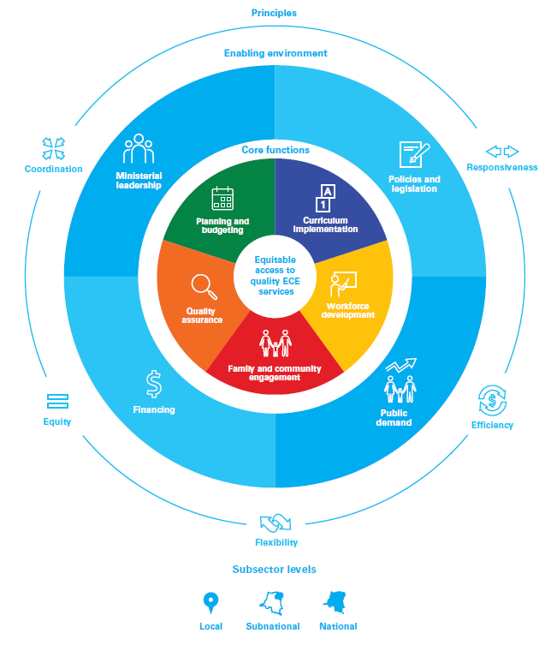

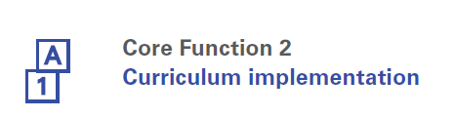

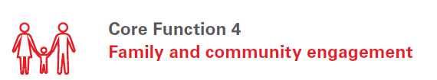

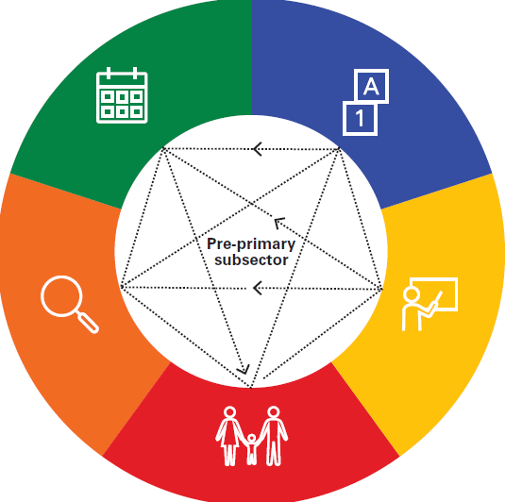

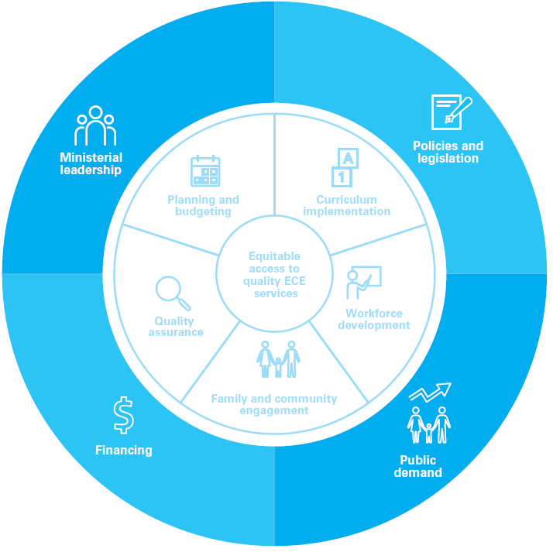
Preview of the workshop
DAY 1
DAY 2
DAY 3

Slide 7

Participant Introductions and Perceptions
How many of you are working as part of a national government?
Sub-national government?
University/Academic institution?
Civil Society organization/ NGO?
Multi lateral agency/donor?
Any other affiliation we missed?
Notes:
Activity 1

Slide 8
Pre-Primary Education in [country]:
Overview, Challenges, and Opportunities
Introduce, or re-introduce yourselves to those at your table: How does your work support the country’s pre-primary education subsector?
Discuss at your table your perceptions of:
  (a) the strengths; and
  (b) the challenges in the current pre-primary subsector.
Write down examples of strengths and challenges on sticky notes as a group
Post these on the chart paper

Slide 9

Premises of Working Together
Collaborative and participatory approach
Active participation is the precondition for creating joint vision and defining priorities
Open mindedness; being open to stepping out of your comfort zone
Listening to each other and building a common understanding
Healthy and constructive debate, where needed
Result-oriented, we need to stay focused and work towards practical outcomes of this workshop

Slide 10
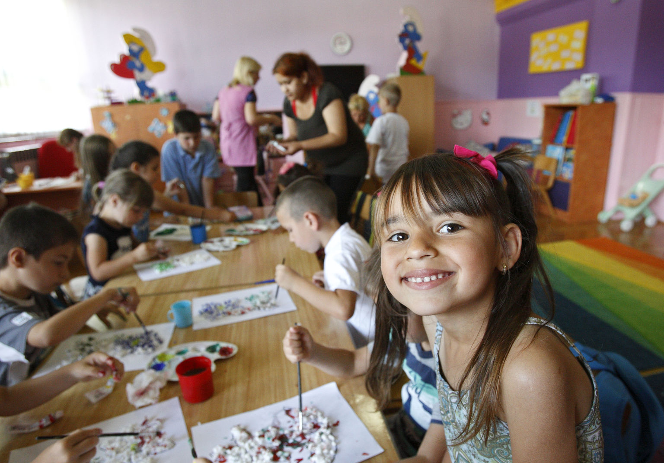

Setting the stage:
Pre-Primary Education in [country]
Notes:
Change the photo as needed and relevant.
Government presentation on pre-primary education in the country

Slide 11

Notes:
These “break time” slides have been inserted in various places – please move them as needed, or not use them if you want to keep the workshop/convening more flexible.

Slide 12

Accelerating Access and Quality in Pre Pre-Primary Education:
UNICEF’s Conceptual Framework and Diagnostic and Planning Tool
Marilou Hyson, UNICEF Senior Consultant, Early Childhood
Macedonia, 2018
Introduction to Conceptual Framework and the Pre-primary Subsector Analysis Tool
Notes:
This begins the overview presentation about the CF and Tool. See Activity 2.
Change the photo as needed and relevant.

Slide 13
Presentation Overview
Brief Background and Rationale
Presentation on Conceptual Framework for the pre-primary subsector
  Why and what?
  How might it be useful for [country]?
Introduction to the Pre-primary Subsector Analysis Tool

Slide 14

What Is the Important Question?
The question is NOT “Why does early childhood education matter?” We know the answer.
BUT
“How can we most effectively ensure quality pre-primary opportunities for all children?”
This is much more difficult to answer!
Notes:
At least among us, there is no question about the importance of the early years and of the value of early learning. (of course, there are still those who need to be convinced). But looking at the SDGs, and especially Goal 4, leads us to focus on THE QUESTION: HOW we can work together, in this country and in other countries, to ensure that ALL children experience learning opportunities that are accessible and of high quality.

Slide 15
Pre-Primary Education in the broader ECD landscape
Pre- Primary Education
Initial stage of organized instruction through organized early learning programs in the preschool years
[Country]:
If applicable, include the relevant terminology and definition of ECE or pre-primary education in the country

Slide 16

Objectives of the Conceptual Framework
  To provide countries with a systematic, coherent approach to planning how to support pre-primary education. A systems perspective strongly influenced the framework and guides its use.
  To help identify the essential elements of an enabling environment and core functions for an effective subsector.
  To help countries set a solid foundation around which other work can be organized, including the development of a pre-primary subsector implementation plan.
What are the desired results?
  Ministries and their partners will develop a shared, strategic vision, leading to system-building investments in pre-primary education;
  Countries will design a roadmap that can guide them through the bottlenecks and challenges facing governments who are interested in expanding access to quality pre-primary education.
Notes:
Main talking points:
There are different structures, entities, functions, elements, levels of governance and operations → systematic and coherent approach helps bring all of these together
Countries may use this framework to construct an understanding of what is required to develop a strong pre-primary subsector. The framework is also intended to help national partners reflect on and identify the strengths and gaps of the existing ECE context, while providing a roadmap for addressing the challenges that governments may face in expanding access to quality pre-primary services.
It is important to link to the broader education sector.
The framework also aims to position pre-primary education more centrally in the planning and budgeting processes of Ministries of Education as a necessary step to ensure better investment and focus in this area.

Slide 17
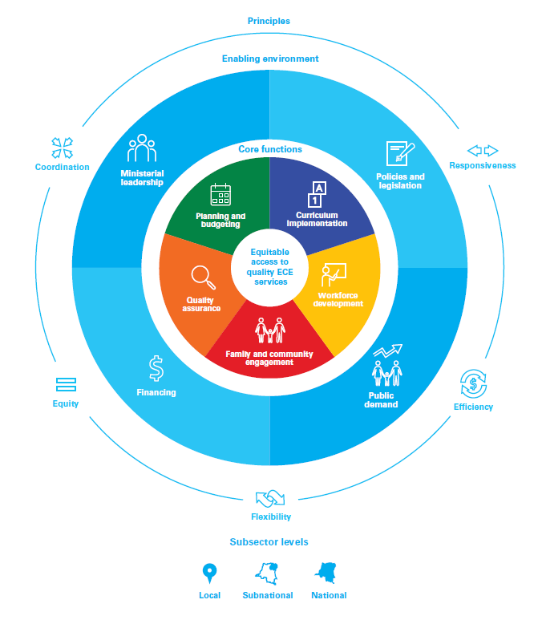
Pre-Primary Subsector Conceptual Framework
Children’s learning and development outcomes are the reason why a strong pre-primary subsector is so important. Reaching these outcomes depends on equitable provision of quality pre-primary education.
Effective pre-primary education subsector requires a number of enabling factors and systematic work in five key areas.
A supportive or enabling environment that can help leverage political, public, and financial resources for the pre-primary sub-sector
Five core functions that are essential to the development and sustainability of high quality pre-primary education
Notes:
Main talking points:
The conceptual framework identifies the building blocks for an effective pre-primary subsector. At the heart of the CF is equitable provision of quality pre-primary education.
There are two layers: (1) enabling environment; (2) core functions
The CF offers countries a frame of reference and basic blueprint that can and should be adapted to different contexts and circumstances.

Slide 18

Sharpen our understanding of the pre-primary system and all its parts
Notes:
Main talking points:
Quality is not a stand-alone entity of education for young children in this framework. It is the sum of many interlinked components.
Each core function stands on its own, but they are each a piece of a bigger whole and are all interconnected.
Each core function is essential to delivering quality pre-primary services and to ensuring children’s optimal learning and development.

Slide 19

Notes:
Main talking points:
Then transition into the next part of the presentation by saying that we will now look at each of the Core Functions separately. When your teams begin to work with the Tool, you will be using these same Core Functions, discussing in detail what are your country’s major challenges and priorities in each Core Function, and later in the workshop identifying strategies/actions that may be needed to strengthen the system.
This presentation will give an overview of the core functions – when you begin the work with the Tool, we will have more details about each core function.

Slide 20
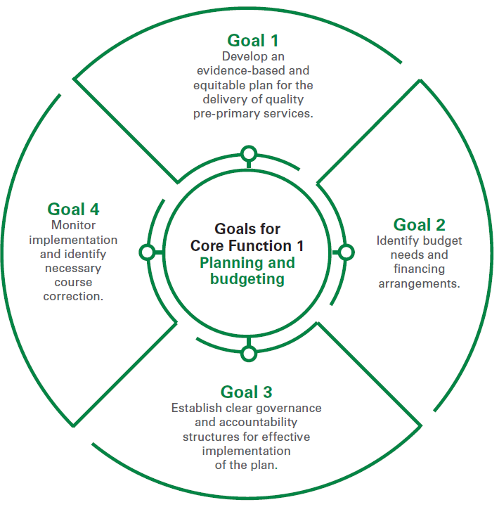
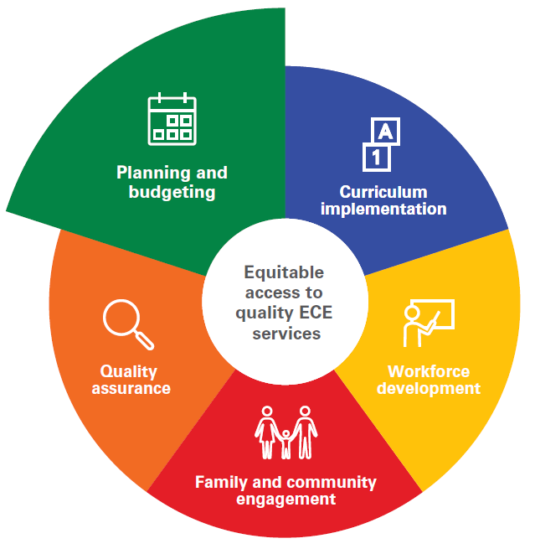
Core Function 1:
Planning and budgeting
The purpose of this core function is to develop strong and responsive subsector plans, across levels of government, for equitable provision of quality pre-primary education, making efficient use of available financial, human and physical resources.
Notes:
Main talking points:
The framework looks as both foundational elements of each core functions (for example, curriculum, quality standards, teacher competencies profiles), as well as looks carefully at system’s ability to implement and put these into practice.
A key feature/strength of the framework is that it goes unpacks the core functions and breaks them down in manageable chunks (goals).
If the goals are achieved, it is more likely that this part of subsector is functional.
Each core function has technical nuances (curriculum → we need cadre of professionals within curriculum arm who have knowledge, etc.; planning → sensitization to types of programmes)
Go through the goals quickly for this core function → In many ways, this core function is the backbone of the subsector – connects with all other core functions.

Slide 21
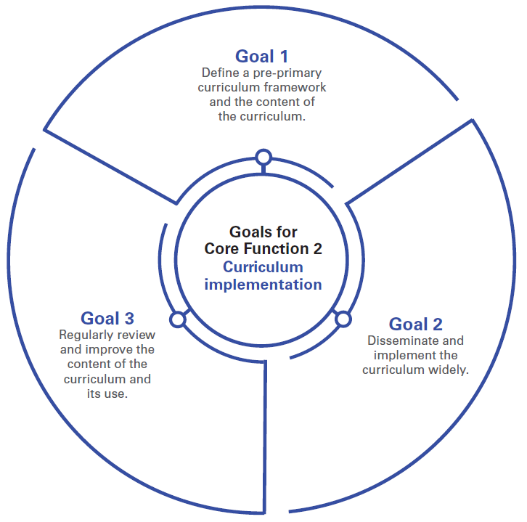
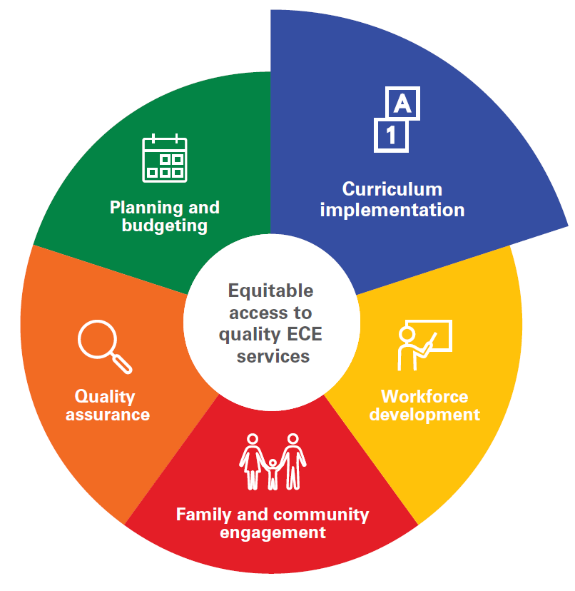
Core Function 2: Curriculum development and implementation
The purpose of this core function is to ensure that children across early learning settings benefit from a developmentally appropriate curriculum and have access to learning and play materials that stimulate their development.
Notes:
Main talking points:
The pre-primary subsector has the responsibility for guiding a process that brings knowledgeable stakeholders together to identify the best curriculum approaches for the country’s children.
This core function is also about ensuring that developmentally appropriate teaching and learning materials are available.

Slide 22
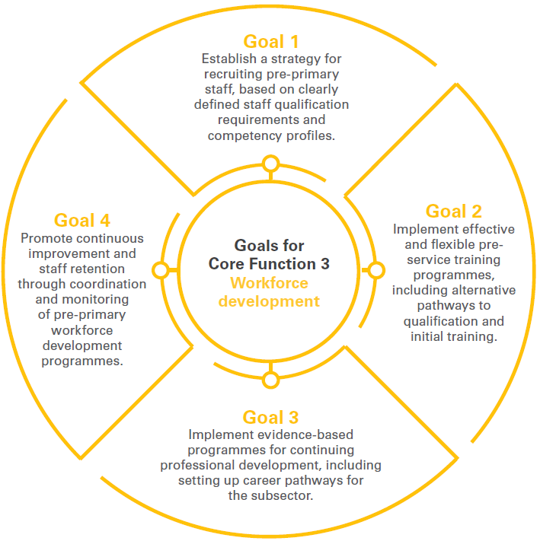
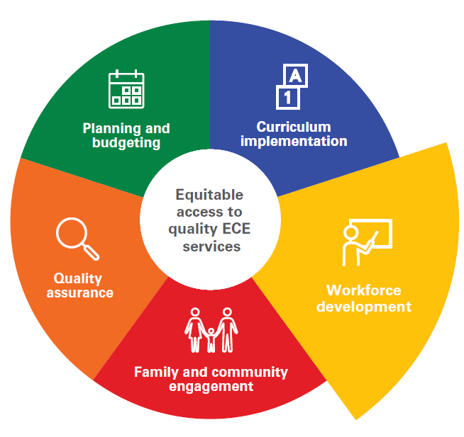
Core Function 3: Workforce development
The purpose of this core function is to support the recruitment, development and retention of a sufficient number of pre-primary teachers and other key personnel into the subsector, ensuring that they have the essential competencies, training and support required to promote children’s positive development and early learning.
Notes:
Main talking points:
Highlight that this core function is not only about teachers, but also other personnel (directors, supervisors, etc.).

Slide 23

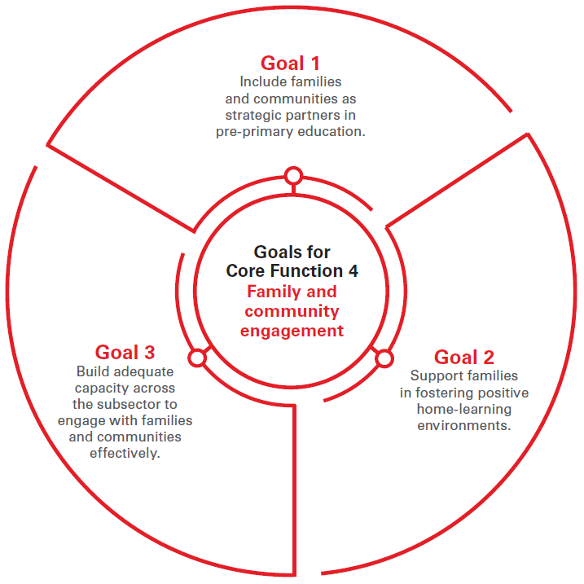
Core Function 4:
Family and community engagement
The purpose of this core function is to ensure that families and communities are active participants and partners in supporting children’s learning and development across early learning settings.
Notes:
Main talking points:
This core function is a distinctive feature of pre-primary subsector – serves as a bridge between early stimulation and early learning at home (on the one hand) and formal school/education systems (on the other hand).
Helping families support children’s learning and development at home (continuity between school, home, community)
Engaging families/communities in pre-primary programmes

Slide 24
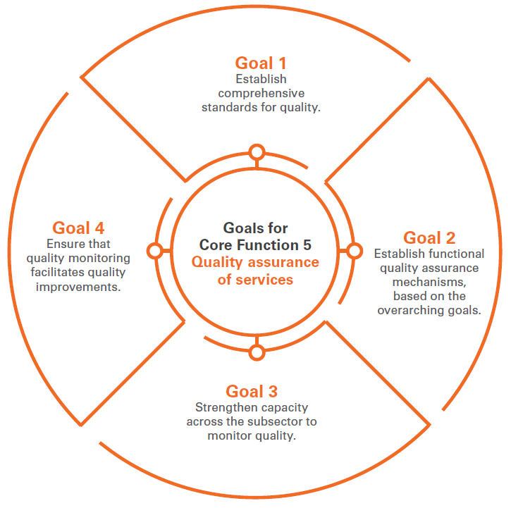

Core Function 5: Quality Assurance
The purpose of this core function is to ensure that a coherent framework for monitoring and quality assurance of pre-primary education is in place and that quality monitoring is used to support continuing improvements in both policy and practice.
Notes:
Main talking points:
Monitoring, regulating and ensuring quality helps ensure efficiency, effectiveness of subsector
We need a coherent quality assurance system; build feedback loops within subsector (continuously reflecting on what’s working and what’s not working)
This is not just about having indicators and framework; it is also about using data to improve and make course corrections
Monitoring only matters it feeds into practices

Slide 25
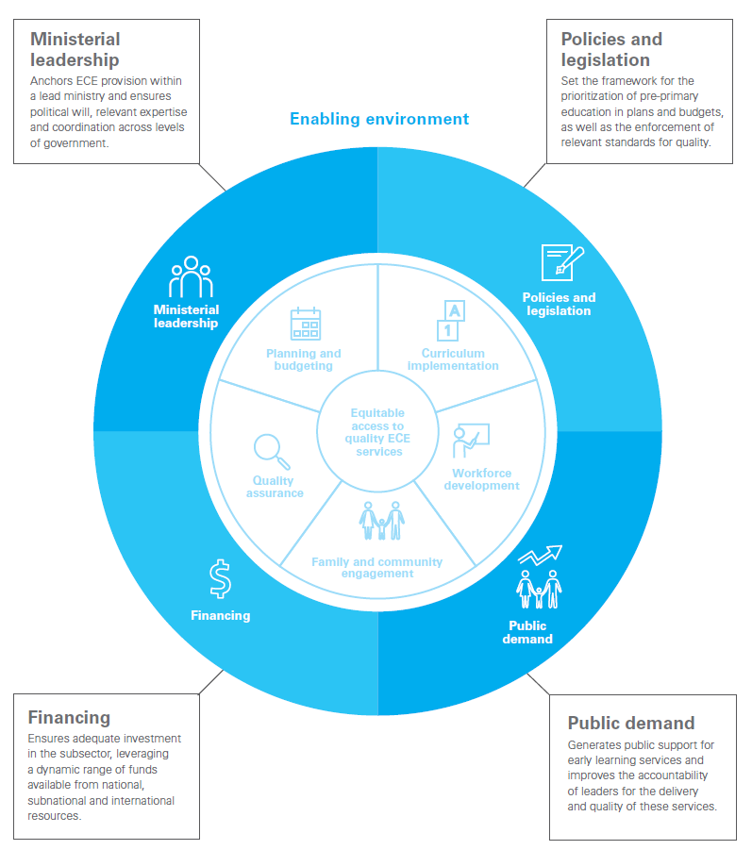
Notes:
Main talking points:
Refers to broader interrelated conditions that surround the development of pre-primary education subsector.
The various factors in the national context that can either hinder or facilitate the successful development of the sub-sector and its provision of quality pre-primary services.

Slide 26
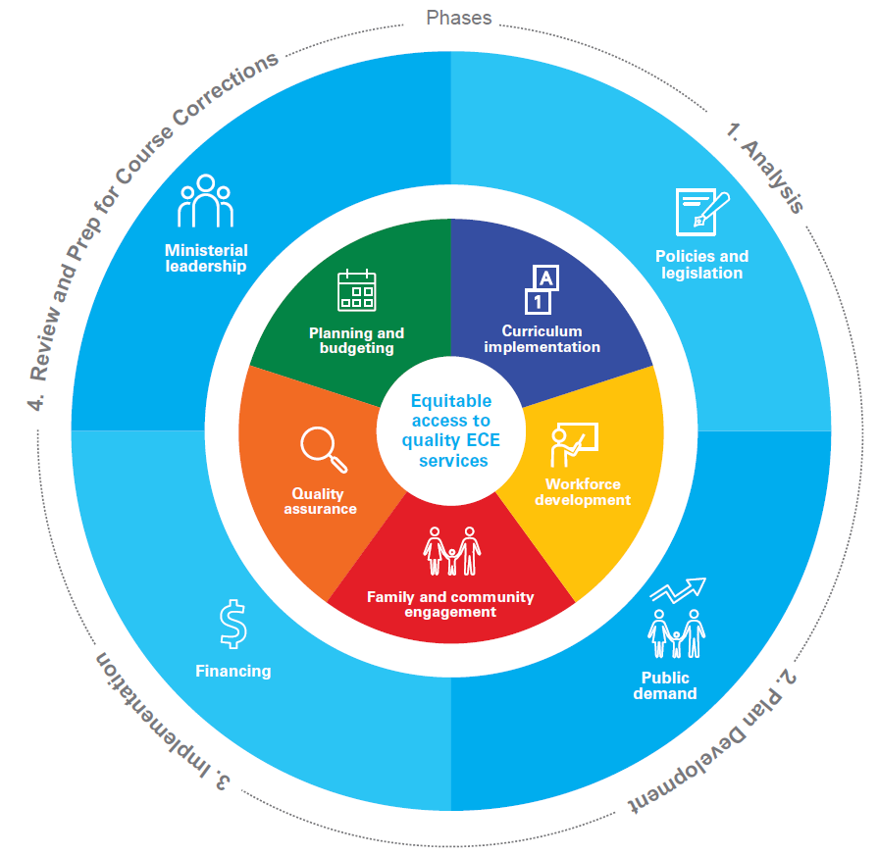
Applying the CF in the context of Education Sector Planning
Notes:
Main talking points:
In many countries in the region, pre-primary is already part of Education Sector Plans → but they are time-bound and we can improve the way it is included in education sector plans
Conceptual framework & tool can be helpful to improve the plan, budgeting, implementation (depending on phase of Sector Planning process)
Analysis in preparation of the plan → would be interesting to use CF to analyze the context of pre-primary education and to use that towards plan development (to identify gaps, issues, etc.)
Plan development: helpful to use conceptual framework → Plan should ideally address the Core Functions (use the conceptual framework to reflect on and formulate a plan that is comprehensive and coherent)
Implementation: when thinking about improving the Plan → conceptual framework could be helpful to look at what’s working and not working
Example- Niger and Guinea using the framework to deepen Education sector analyses chapter; Ghana is about to engage in the workshop to inform its plan ; Nepal (mid-term review)

Slide 27

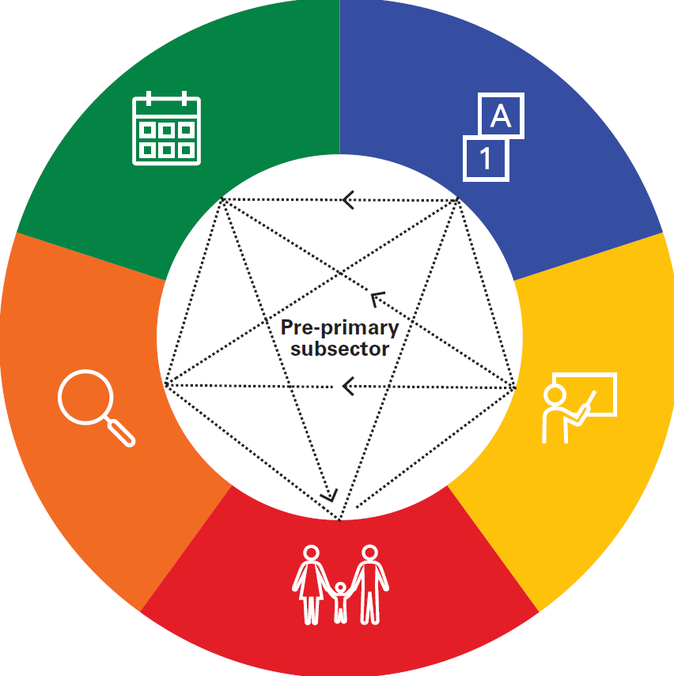
Connecting Across Core Functions
The Problem: Different Core Functions often sit in different parts of the government
and therefore may lack coherence.
2+2 does not always equal 4
In reality, all Core Functions are closely connected and
influence one another.
→ coherence, consistency, and coordination across all Core Functions is crucially important
Notes:
Main talking points:
Working independently on action areas does not produce maximum results
Coherence and coordination of all core functions is crucial
Navigating decisions and options that governments have
Each core function has a distinct focus – but they are all connected and mutually influence and reinforce one another – therefore maintaining coherence and coordination across the core functions is crucial – for example, when developing or revising curriculum, teacher training programs should be updated accordingly to ensure that teachers are well-versed in the new or revised curriculum
Different bodies responsible for different parts of subsector – conceptual framework creates coherence between roles and accountabilities associated with each core function

Slide 28



Subsector-Building Principles
Equity
Decisions about pre-primary services ensure fair access for all children
Efficiency
Thoughtful, evidence-based decisions consider how to create the greatest benefits within the available resources
Flexibility
Countries, contexts and cultures differ greatly, so the framework does not recommend a rigid sequence of steps that should be followed. Rather, it is meant to be adapted, added to or prioritized in ways that make sense in a specific context
Responsiveness
The design of pre-primary systems and services takes the likely changes in national and local contexts, cultures and needs into account
Coordination
The process reflects dynamic, ongoing interactions between sectors beyond education (health, nutrition, social welfare, child protection) as well as the pre-primary subsector and other education subsectors
Notes:
Main talking points:
In conceptualizing the development and maintenance of pre-primary systems, five overarching principles – Equity, Efficiency, Responsiveness, Flexibility and Coordination – increase the likelihood that planning and operations of pre-primary programmes serve the goal of reaching the focal populations as well as enduring over time. The conceptual framework weaves these across all core functions, and they are important to keep in mind in “testing out” the current condition and future plans for your pre-primary subsector. These also align with what is emphasized in the SDGs.

Slide 29




Subsector or System Levels
A strong pre-primary sub-sector is only as strong as its district- or local-level structures, capacity etc.
To ensure effectiveness, there must be coordination and vertical alignment from national to local levels.
Notes:
Main talking points:
Although discussions of system-building often concentrate on the national level (e.g., the administrative functions of ministries, central budgeting, national standards setting, etc.), a strong pre-primary subsector is only as strong as its district- or local-level implementation. For example, a country’s pre-primary curriculum guidelines may be well designed but fail to be enacted in communities because of lack of adequate local teacher professional development. Another example would be, central budget allocations may not make their way to pre-primary services because funds are redirected to other district priorities or expenditures are not tracked through transparent accountability systems.
Not only downward but also upward – example: pedagogical practices that are proven to be effective can translate into revised teacher training, etc.
The activities and operations of the pre-primary sub-sector occur at multiple levels: the national or central; the sub-national (the provincial or regional or state level); and the local (in some countries, the district or sub-district level; in urban areas, the municipal level). To facilitate sub-sector development, some form of coordination and communication is needed across these different levels, particularly in countries with decentralized/deconcentrated systems. The aim is to ensure coherence, consistency, and efficiency in pre-primary services for children in all settings

Slide 30


Building a strong system
Harder work
Has cost implications
May take longer
But in the long run pays off

Slide 31

What’s Next?
Move from broad goals to specific analyses to comprehensive operational plans

Slide 32
The Pre-primary Subsector Analysis Tool Can Help!
  Based on the Conceptual Framework
  Helps national stakeholders reflect on and assess the strengths and gaps of pre-primary subsector
  Includes “modules” for each Core Function and the Enabling Environment
  Questions will help you analyse your country’s pre-primary subsector
  Designed to be used during a workshop like this
  Intended to be used flexibly to fit your country’s context and needs
  Will help you develop a roadmap and a coherent strategy to strengthen the subsector and address bottlenecks and challenges
Notes:
Main talking points:
Practical tool which very systematically supports countries to analyze the subsector’s strengths and challenges and leads to the development of a coherent action plan that can in turn be integrated into or inform Education sector plans, costing models, donor proposals, partner investment and more.

Slide 33
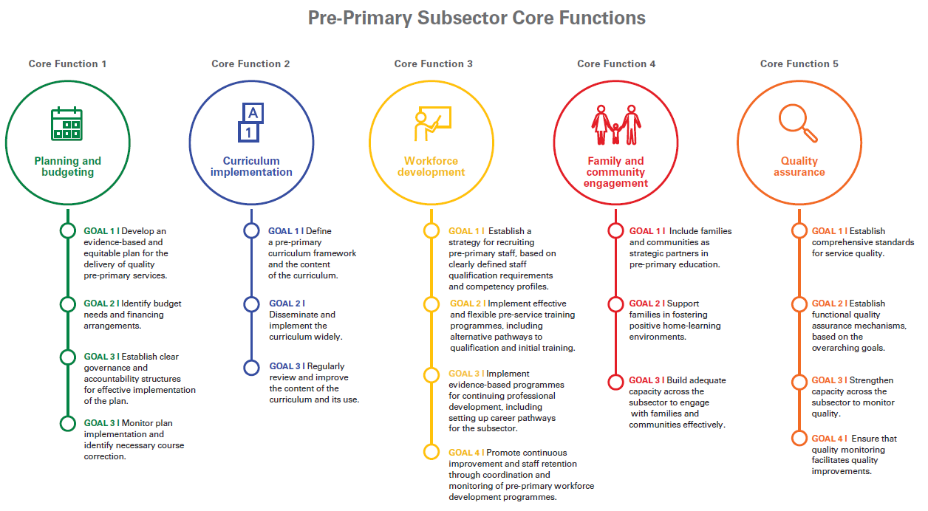
14 measures
11 measures
14 measures
10 measures
15 measures

Slide 34
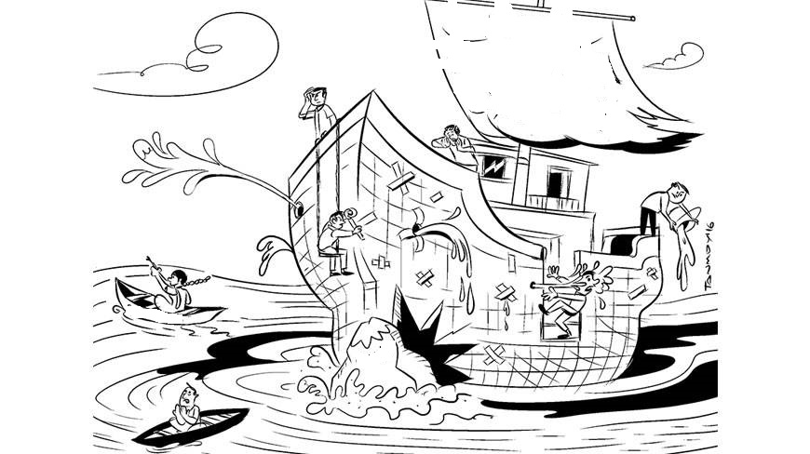
Analyze your subsector, diagnose it, understand what works and what doesn't, and plan for strengthening the weak spots

Slide 35
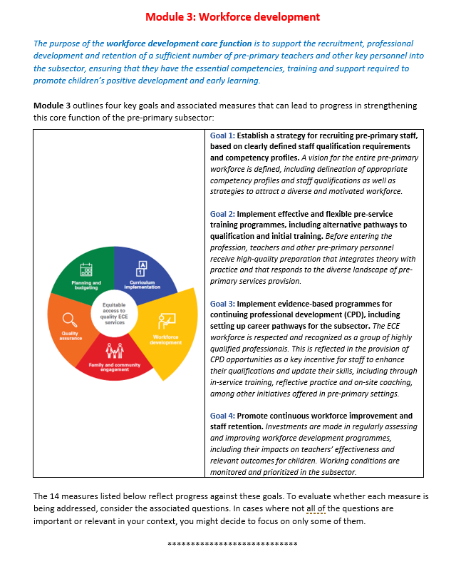

Notes:
Talking points:
All modules begin with a brief description of the purpose and focus (the core function or key factor in the enabling environment), followed by extensive content on:
Goals the pre-primary subsector should prioritize in order to build a stronger system and achieve results for children.
Measures of progress for each goal. The measures are intended to encourage self-assessment and reflection, and to support monitoring of the pre-primary system’s performance.
Questions to accompany each measure. These questions do not cover every possible topic, and they may not all be relevant to your country’s context. They are intended to jump-start dialogue on some of the issues to consider in achieving the measures of progress.

Slide 37

In-Depth Introduction to Core Function 1:
Planning and budgeting
The purpose of this core function is to develop strong and responsive subsector plans, across levels of government, for equitable provision of quality pre-primary education, making efficient use of available financial, human and physical resources.
Why is this core function important and challenging?
Guides overall development of the subsector: the backbone
Pre-primary subsector is complex; multiple departments; multiple providers
Result can be uneven access and quality of services; key needs fall through cracks
Collaborative planning; Governance structures; Planning capacity; Clearly defined responsibilities
Notes:
Main talking points:
The aim of this core function is to build well-thought-out action plans and resource management systems that will connect with and guide all aspects of the subsector.

Slide 38

What is the vision?
How do we implement it?
Notes:
Main talking points:
Core function 1 involves clarifying the vision for pre-primary education – in terms of access and in terms of sustainability and developing

Slide 39
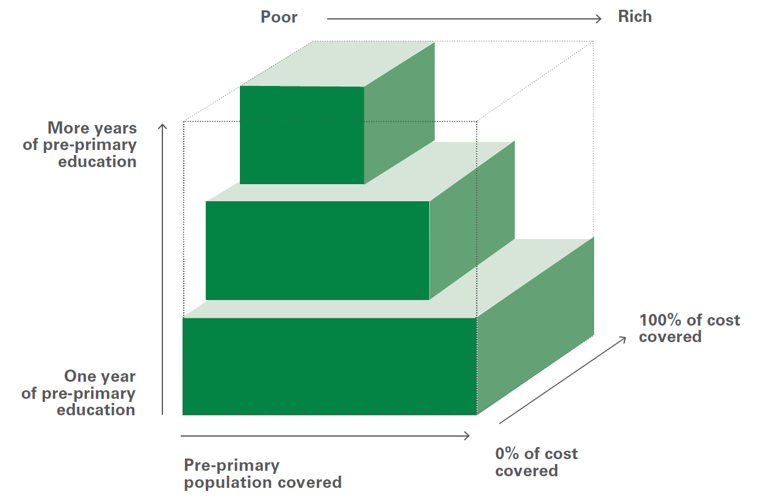
What does Core Function 1 entail?
Universal access vs. Progressive universalism?
Progressive universalism means expanding provision of quality education for everyone while prioritizing the needs of the poor and disadvantaged first. It provides a guiding principle to inform spending decisions, recognizing the scarcity of public funding
Who needs the services?
Who will provide services?
What would those services be?
Who will plan for the provision?

Slide 40
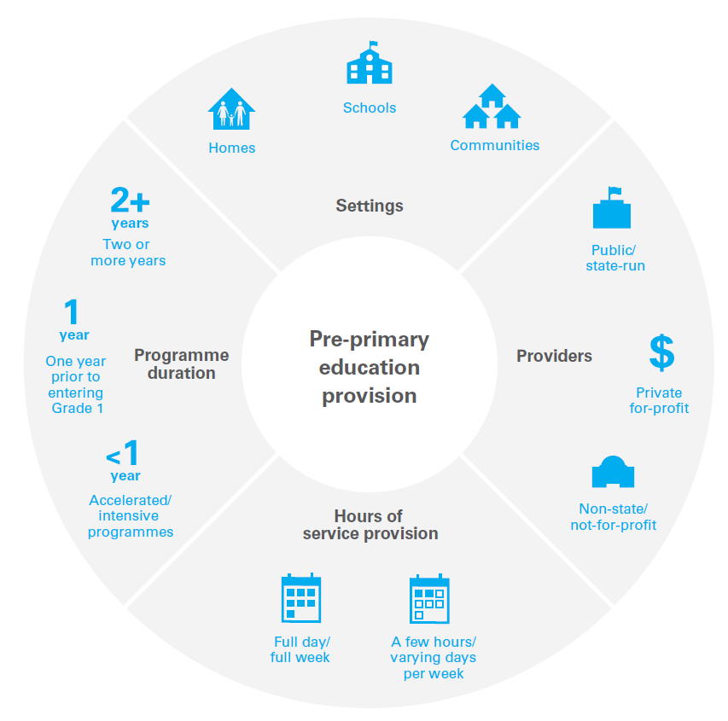
Notes:
Main talking points:
Added layer of complexity to the subsector – variety of actors and providers (primary close to 90% is public)
In this rich landscape, the role of government is not necessarily as sole provider, but rather as provider as well as coordinator, setting guidelines, setting the vision
This complex landscape of pre-primary education provision sets aside the pre-primary subsector from other sub-sectors

Slide 41
[Country’s] presentation on Planning and budgeting
Notes:
Insert slides for the country representative’s presentation on Core Function 1 (Planning and budgeting)

Slide 42


Slide 43
Using the Tool to Analyze Core Function 1:
Team Discussion, Identification and Prioritization of Challenges

Slide 44

Steps for This Task
Everyone should have their copy of the Tool,
turned to Core Function 1. One person will help guide the discussion
and another will take notes on the discussions.
Discuss each Goal, focusing on the goal’s Measures of progress, using the questions. Spend more time on the questions that are most relevant for [country].
Agree on the team’s “assessment” of the Measures within each Goal, noting any comments and rationales for the assessment.
Finally, consider what are notable strengths and then agree on what are the 2 or 4 biggest challenges in this Core Function. You do not have to select just 1 measure of progress; consider combining several problem areas into a larger challenge if possible.
Use chart paper to display your group’s deliberations.
Notes:
Note: Facilitators need to keep track of time and tell them when they have 15 more minutes.

Slide 45
Template for Wall Chart
Core Function X
Major challenges in this Core Function: Main strengths:
1. 1.
2. 2.
3. 3.
4. 4.

Slide 47
Plenary Discussion and Summary of Challenges
Notes:
See the Activity directions.

Slide 48

Day 1 Wrap-Up
Summary
Feedback, questions, comments
Preview of Day 2

Slide 49
Getting Started on Day 2
Overnight reflections, questions, issues
Preview of Day 2’s tasks
  Complete discussion, analysis, and prioritization of [country’s] issues and challenges for all remaining Core Functions
Notes:
Note: Just a review and preview—5 mins unless major overnight issues

Slide 50
A few reflections…
Notes:
Note: Use this slide to document synthesis of Day 1 results and reflections

Slide 51
The Situation of ECE Curriculum and Teachers:
Overview, Challenges and Opportunities

Slide 52
Tasks for Analysis of Core Function 2 (Curriculum) and Core Function 3 (Workforce)
In-depth introduction to each Core Function.
Team discussion and analysis of each Core Function.
Sharing with another team to consolidate challenges. Reflect and consider suggestions.
Whole-group discussion and further prioritization of challenges if needed.
Notes:
Note: This is a preview of the process of the analysis and concensus-building.

Slide 53

In-Depth Introduction to Core Function 2: Curriculum Development and Implementation
The purpose of this core function is to ensure that children across early learning settings benefit from a developmentally appropriate curriculum and have access to learning and play materials that stimulate their development.
Curriculum answers the questions, “what to teach?” and “how to teach it?”. It refers to the contents and methods that strengthen children’s learning and development.
A curriculum framework (which includes guidelines and standards) is a tool which guides the content of and approach to children’s learning and development.
Curriculum content is usually organized into subject elements or learning areas and is often presented in a sequential manner.
Teaching and Learning materials are the resources that support the implementation of the curriculum and that enable it to come to life in the classroom - including toys, books, manipulatives, teacher guides and others.
Notes:
Main talking points:
Curriculum is influenced by many factors (e.g., society’s values, content standards, research, community and family expectations, culture, language) and can take many forms, without there being a “best” curriculum approach.
Teaching and learning materials are often considered part of the broad concept of “curriculum,” because these resources support curriculum implementation and help the curriculum come to life.
Questions to ask: Who is responsible for reviewing/monitoring/and implementing curriculum in your country? Is there a timeline for the development or revision of existing curriculum? Is curriculum mandated to be used by all service providers, including private?
Highlight: curriculum; standards and supporting teaching/learning materials (at the heart of this: developmentally appropriateness)
Curricular Framework and Contents: Define a curricular framework and contents: Ideally, curriculum framework and content are aligned with other subsectors for continuous learning and developed through broad consensus and vision
Curriculum Dissemination and Implementation: Disseminate and implement the curriculum widely and effectively by building the capacity of pre-primary institutions to understand the curriculum, including its vision, pedagogical aims, and contents, and to support pre-primary personnel implement the curriculum and its associated learning resources
Curriculum Review: Review and improve the content and use of the curriculum: Curriculum should also be reviewed regularly and implementation should ideally be assessed with regular monitoring and evaluation, to identify improvements or changes that may be needed.

Slide 54
Using the Tool to Analyze Core Function 2:
Team Discussion, Identification and
Prioritization of Challenges

Slide 55

In-Depth Introduction to Core Function 3:
Workforce Development
The purpose of this core function is to support the recruitment, development and retention of a sufficient number of pre-primary teachers and other key personnel into the subsector, ensuring that they have the essential competencies, training and support required to promote children’s positive development and early learning
Who is the pre-primary personnel that should
be considered here?
Teachers
Other personnel include:
    Principals/program directors
    Inspectors/supervisors
    Providers of pre- and in-service professional development
    Other support staff (such as paraprofessionals or disabilities specialists)
Notes:
Main talking points:
Emphasize central importance of workforce development and that in most countries this is very challenging, lots of bottlenecks.
This workforce includes classroom teachers as well as managers or principals, supervisors, trainers and others who provide both in-service and pre-service professional development, and those who offer specialized services. Whatever their role, the members of this workforce share distinctive pre-primary competencies as well as competencies necessary to their specific responsibilities
The ability of qualified teachers to create an engaging environment through sensitive, positive and stimulating interactions with children makes a difference in children’s learning and development

Slide 56
Using the Tool to Analyze Core Function 3:
Team Discussion, Identification and
Prioritization of Challenges

Slide 57
Presentation from [country] on the current situation and future plans
- Core Function 2 (Curriculum development and implementation)
- Core Function 3 (Workforce development)
Notes:
Note: Insert slides for country representatives’ presentations on Core Function 2 and Core Function 3

Slide 58
Steps for This Task
Half of the teams will analyze Core Function 2 and the other half Core Function 3.
Discuss your team’s Core Function, looking at each Goal, focusing on the Measures of progress and using the questions. Spend more time on the questions that are most relevant for [country].
Agree on the team’s “assessment” of the Measures within each Goal, noting any comments and rationales for the assessment.
Finally, consider what are notable strengths and then agree on what are the 2 or 4 biggest challenges in this Core Function. You do not have to select just 1 measure of progress; consider combining several problem areas into a larger challenge if possible.
Use chart paper to display your group’s deliberations.
Notes:
Note: Facilitators need to keep track of time and tell them when they have 15-20 more minutes.

Slide 60
The Next Step:
Consolidate your findings with another group

Slide 61
The Next Step:
Sharing, Summary, and Plenary Discussion of Challenges
for Core Functions 2 and 3

Slide 63
The Situation of Family and Community Engagement &
Quality Assurance:
Overview, Challenges and Opportunities

Slide 64

In-Depth Introduction to Core Function 4: Family and Community Engagement
The purpose of this core function is to ensure that families and communities are active participants and partners in supporting children’s learning and development across early learning settings.
Guiding Principles: Respect for all families; responsiveness to family and community characteristics and needs; focus on practical resource and support
Notes:
Main talking points:
The concept of “family and community engagement” includes the wide variety of ways in which young children’s parents and other relatives, and the broader community in which they live, become connected with pre-primary services. The scope of “community” includes, for example, neighbourhoods, NGOs, faith organizations, and other services focusing on child development, such as social and health services. → resources, networks
Parents are indeed children’s “first teachers” and should be supported in this role. Whether they are enrolled in pre-primary programs or not, young children spend most of their time at home in the early years, interacting with parents, siblings, extended family members, and neighbours. Research has shown that when family members promote children’s early learning at home and when they connect with staff in their children’s pre-primary programs, there are many benefits. This kind of engagement enhances children’s developmental and academic achievements, and it helps create stronger connections and better transitions between home and school environments. For these reasons, parents have the right to be informed of and to participate in key decisions concerning their child. Additionally, respectful partnerships with families give teachers deeper knowledge about the children they teach, helping teachers be more responsive to the needs of children and their families.

Slide 65
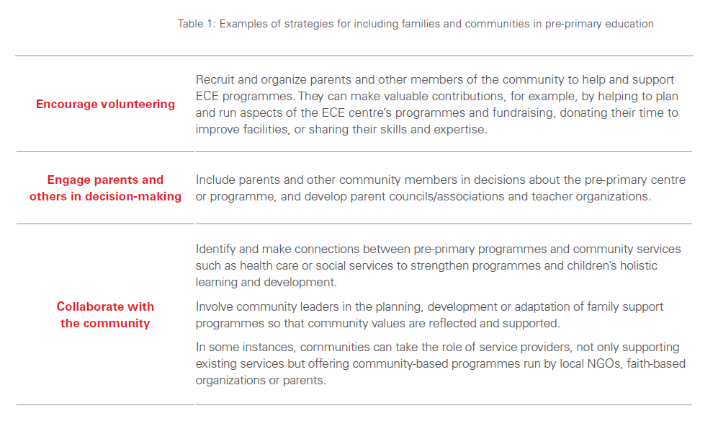

Slide 66
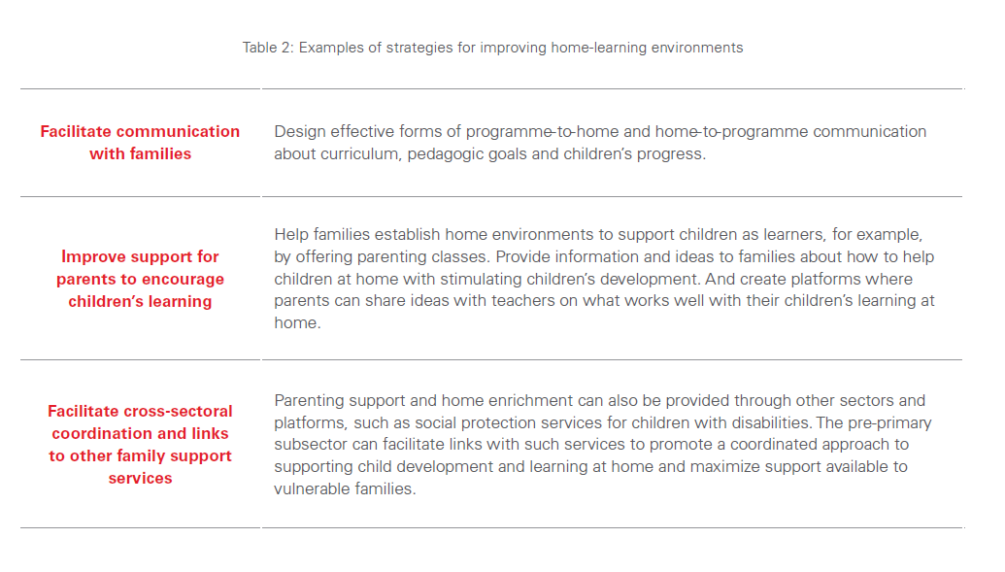

Slide 67
Using the Tool to Analyze Core Function 4:
Team Discussion, Identification and
Prioritization of Challenges

Slide 68

In-Depth Introduction to Core Function 5: Quality Assurance
The purpose of this core function is to ensure that a coherent framework for monitoring and quality assurance of pre-primary education is in place and that quality monitoring is used to support continuing improvements in both policy and practice.
Successful implementation of pre-primary services requires a commitment to ongoing quality improvement and oversight of services;
Monitoring refers to the ongoing evaluation of system performance for accountability as well as for rating programme quality, highlighting trends and informing planning and implementation.
Monitoring can play a crucial role in promoting better services and child outcomes, assuring that standards and regulations are followed and that children receive appropriate care and education, keeping track of workforce supply and condition.
Notes:
Monitoring only matters it feeds into practices (bottlenecks: if no coherent framework, scattered data)

Slide 69
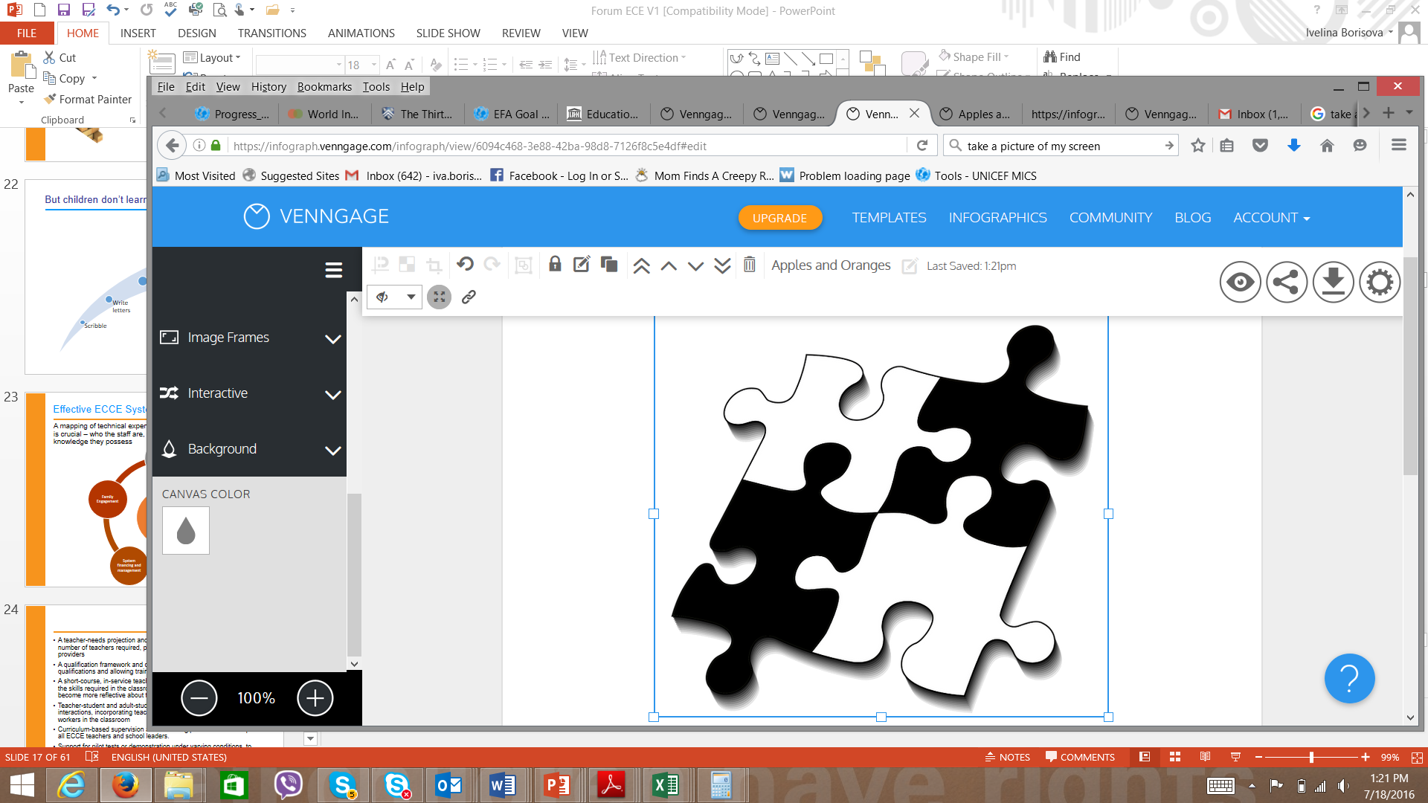
Monitoring services in the complex context of diverse service providers
Private, NGO and
other providers
Formal, public preprimary
Home based support,
others
Accelerated and
innovative models
Notes:
Main talking points:
When it comes to oversight and quality assurance, we should be looking at the whole puzzle not just one puzzle piece.
How do we extend monitoring not just to public sector but incentivize other providers to participate in service monitoring and quality assurance?

Slide 70
Using the Tool to Analyze Core Function 5:
Team Discussion, Identification and
Prioritization of Challenges

Slide 71
Presentation from [country] on the current situation and future plans
- Core Function 4 (Family and community engagement)
- Core Function 5 (Quality assurance)

Slide 72
Steps for This Task
Half of the teams will analyze Core Function 7 and the other half Core Function 5.
Discuss your team’s Core Function, looking at each Goal, focusing on the Measures of progress and using the questions. Spend more time on the questions that are most relevant for [country].
Agree on the team’s “assessment” of the Measures within each Goal, noting any comments and rationales for the assessment.
Finally, consider what are notable strengths and then agree on what are the 2 or 4 biggest challenges in this Core Function. You do not have to select just 1 measure of progress; consider combining several problem areas into a larger challenge if possible.
Use chart paper to display your group’s deliberations.
Notes:
Note: Facilitators need to keep track of time and tell them when they have 15-20 more minutes.

Slide 73
The Next Step:
Discuss Your Team’s Findings with a Team That Analyzed a Different
Action Area
Now sit with a team that discussed a different Action Area
Explain your scoring and highest priority challenges to the other group.
Invite everyone’s feedback and further suggestions (they have experience, too!
Use feedback as needed to revise or add to lists of priority challenges as needed.
Notes:
See directions for Activity.
Note that this is an extra step because different groups are looking at different Aas
This did not take very long, I think because the challenges identified were relatively few

Slide 74
The Next Step:
Consolidate your findings with another group

Slide 76
Plenary Discussion and Summary of Priority Challenges for Core Functions 4 & 5

Slide 77
Day 2 Wrap-Up
Summary
Feedback, questions, comments
Preview of Day 3

Slide 78
Getting Started on Day 3
Overnight reflections, questions, issues
Preview of Day 3’s tasks:
  Putting it all together – top challenges across the 5 Core Functions
  Propose, and sequence, strategies across all action areas that may help [country] move forward toward a more effective pre-primary system
  Consider the Enabling Environment and its potential impact in strengthening pre-primary system and services

Slide 79
Where are we in our workshop
DAY 1
DAY 2

Slide 80
Where we are in our workshop
DAY 3

Slide 81

Putting It All Together:
The Top Challenges Across the 5 Action Areas
Purpose: To consider the challenges as a whole, and to use a group voting method to identify the most important challenges.
Find a partner. Each group of 2 receives 10-15 sticky dots.
Walk past each of the charts, where Core Function challenges are listed. Read and take your time!
Use your dots to choose which challenges seem most important to address with well-planned strategies.
You can use your dots in any or all Core Functions. You do not have to distribute them equally.
Following this, we will briefly discuss the results.

Slide 83

The Challenges You Have Identified: Summary
Notes:
Note: Facilitators need to do a quick tally of the sticky dots and identify with the group the challenges that received the highest number of “votes”. Summarize and discuss with the group in plenary.

Slide 84
Connecting Across Core Functions
The Problem: Different Core Functions often sit in different parts of the government
and therefore may lack coherence.
2+2 does not always equal 4
In reality, all Core Functions are closely connected and
influence one another.
→ coherence, consistency, and coordination across all Core Functions is crucially important
Notes:
Main talking points:
Working independently on action areas does not produce maximum results
Coherence and coordination of all core functions is crucial
Navigating decisions and options that governments have
Each core function has a distinct focus – but they are all connected and mutually influence and reinforce one another – therefore maintaining coherence and coordination across the core functions is crucial – for example, when developing or revising curriculum, teacher training programs should be updated accordingly to ensure that teachers are well-versed in the new or revised curriculum
Different bodies responsible for different parts of subsector – conceptual framework creates coherence between roles and accountabilities associated with each core function

Slide 85

From Challenges to Strategies:
Criteria for Strategies That Can Have an Impact
What are “good” strategies? For example, consider these criteria:
The strategy can have an impact on more than one challenge/issue or more than one Core Function at the same time
The strategy is practical or “doable”(cost, capacity, etc.)
The strategy can be short term - have some immediate (short-term) impact or can be long term (may take longer time) but may initiate reforms that, over time, will influence major changes in the system
The strategy has the “right scope” to be effective: not too limited and not too broad.
Notes:
Our next step will be to recommend strategies or action steps to address the challenges that you have identified.

Slide 86
Example of the “Right Scope”
A Priority Challenge | Strategy May Be Too Broad | Strategy May Be Too Narrow | Strategy May Have the Right Scope
There is no training of pre-primary teachers on the new curriculum | Establish training on the curriculum Include training in the operational plan | Develop a TOR for a teacher training package Pilot an online training program | Establish expert group to plan and develop teacher training modules that can be delivered through various modalities Conduct a scoping exercise on current state of in-service training available and assess what is working, gaps, modalities etc. Develop a costed plan for rolling out the training

Slide 87
A Strategy Is Not Yet a Fully-Developed
Action Plan
Action Plan has precise information about how a strategy is to be implemented. May include:
Specific activities/tasks
Who is responsible for each
Expected outcomes
Etc.—what else?

Slide 88
Defining Strategies and Actions
Frequently, we tend to stick with familiar ideas rather than coming up with new approaches
Think out-of-the-box; new ideas can come from focused facilitation, research, and outside expertise
Choose issues based on goals, available resources, potential financial impact
Take into consideration policy makers’ commitment.

Slide 89


Identify Possible Strategies
Each small group will brainstorm strategies for the challenges in ONE Core Function.
Look at the lists of priority challenges.
Choose no more than 3 or 4 challenges to discuss in each Core Function.
You have about 2 hours for brainstorming of strategies.
Use the large note cards to write brief descriptions of the strategies you propose for each of the challenges noted on the Core Function chart.
Your note cards are color-coded by Core Function. This will help with later discussion. Please write clearly (large letters) and simply.

Slide 90
Connecting Across Core Functions
The Problem: Different Core Functions often sit in different parts of the government
and therefore may lack coherence.
2+2 does not always equal 4
In reality, all Core Functions are closely connected and
influence one another.
→ coherence, consistency, and coordination across all Core Functions is crucially important
Notes:
Main talking points:
Remind participants about connections across Core Functions.
On their strategies cards, place dot stickers/small post-its strips (colour-coded) to identify which other Core Functions are also involved with the strategies.

Slide 91
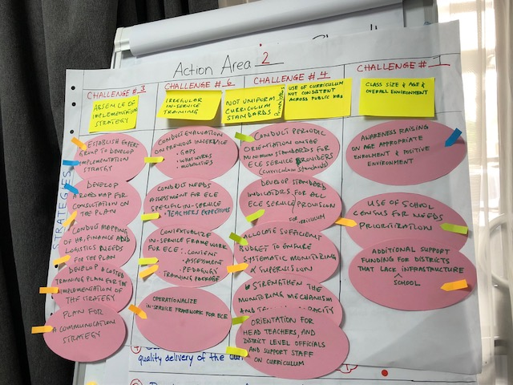
Notes:
Note: This is an example of a chart showing the prioritized challenges in one action area and the strategies that were developed for each challenge.

Slide 93
FEEDBACK TIME!!!
Focused gallery walk
Group 1 (Planning) gives feedback to Group 5 (Quality Assurance) and vice versa;
Group 2 (Curriculum) gives feedback to Group 4 (Families);
Group 4 (Families) gives feedback to Group 3 (Workforce);
Group 3 (Workforce) gives feedback to Group 2 (Curriculum)

Slide 94

Putting Strategies in Context and Sequence
Strategies that are already planned or in progress—perhaps as part of another initiative
Strategies that need to be prioritized for the short term (3-12 months)
Strategies that are important but not for immediate action (12-24 months)
Each Core Function group, please review your strategies and move notes into one of the sequence charts. Where might it fit? Add more strategies if you need to!!!

Slide 95
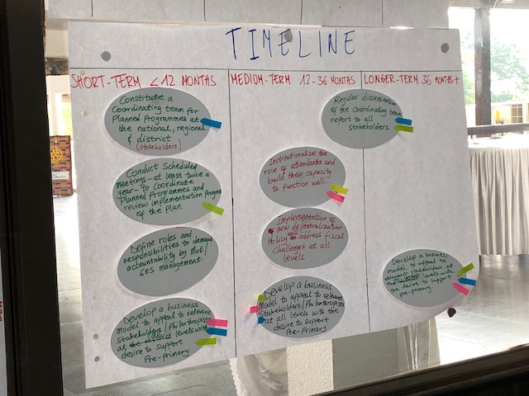
Notes:
Note: An example of a timeline of strategies.

Slide 96

Sharing Examples of Strategies
Each Core Function team selects the main issues and strategies you would like to present to the whole group.
Agree on how you are going to present it in a compelling and clear way.
You may add ideas about what kinds of things would need to be in a developed action plan for the strategies.

Slide 97
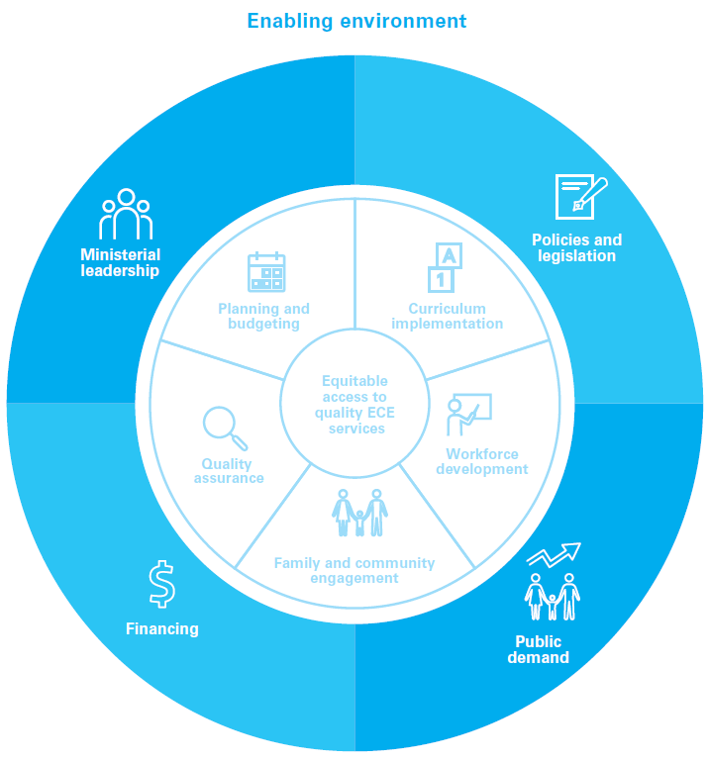
Notes:
Main talking points:
This is the image of a strong pre-primary subsector that we have referred to from the beginning of the first day. Let’s return to it now with special attention to the outer blue ring—what many people call the Enabling Environment.

Slide 98

Ministerial leadership
Advancing the pre-primary subsector requires ministerial leadership accompanied by early childhood education expertise and staff within relevant government bodies and government-related agencies.
Pre-primary leadership can guide the subsector’s vision, development and improvement, prioritizing pre-primary services, giving voice and drawing political support to this work.
Technical capacity in ECD and ECE is critical to develop sustainable plans at central and decentralized levels.
Notes:
Main talking points:
Pre-primary leadership can guide the sub-sector’s vision, development and improvement, prioritizing ECE services, giving voice and drawing political support to this work. In the context of devolution, assignment of significant leadership responsibilities to sub-national and municipal levels is likely to enhance responsiveness as ECE services are planned and put into practice.
The potential of ECE leadership is unlikely to be achieved without expertise on ECE issues. Technical capacity in ECD and ECE is critical to develop sustainable plans at central and decentralized levels.
Coordinated leadership can bring these strands together into an effective whole that can be transformative for the ECE agenda, moving the agenda from a collection of aspirations to a well-designed effort to optimize ECE for all children.

Slide 99

Policies and legislation
Advancing the pre-primary subsector requires policies and legislation that are specific to this subsector and are comprehensive, well-coordinated and linked to implementation.
Policies and legislation embody the overall vision for the subsector.
Inform and support the implementation of quality pre-primary education at the national and sub-national levels, ensuring that pre-primary services will reach broader populations and diverse locations, and that these efforts will be sustained even as leadership changes over time.
The absence of specific pre-primary policies or directives makes it less likely that human and financial resources are mobilized and directed towards this sub-sector.

Slide 100

Financing
Advancing the pre-primary subsector requires adequate public investment, coordinated with other available private and international funding sources.
Adequate public financing is crucial for equitable provision of quality ECE.
Critical to secure both national and sub-national public funding for the essential components (teacher training, program planning, monitoring and quality assurance).

Slide 101

Public demand
Advancing the pre-primary subsector requires a broad national understanding of the importance of early childhood education and shared acknowledgment of these services as a public good.
Without demand and public support for pre-primary education, potential leaders are unlikely to be mobilized or to push for policies, legislation, and funds for this sub-sector.
Take-up by an unaware or uninterested public will be limited.
Well-coordinated advocacy and outreach from stakeholders, families and government officials may become more aware of the role of pre-primary opportunities in children’s school readiness and success.
Outreach to marginalized and vulnerable communities.
Notes:
Main talking points:
Again, note importance—in many countries there is still a lack of awareness of pre-primary educatin’s importance—often the case in rural areas or high poverty areas. Sometimes the challenge is that demand exists but not for (for example) holistic services (education only), or support for “care” but not combined with education.
Without demand and public support for ECE, potential leaders are unlikely to be mobilized or to push for policies, legislation, and funds for this sub-sector. Even if services are established by ECE advocates, take-up by an unaware or uninterested public will be limited, and the services are likely to be unsustainable.

Slide 103

Analyzing the Enabling Environment with the
Pre-primary Subsector Analysis Tool
How are we doing on Policy? Financing? Public Demand? Leadership?

Slide 104
Quick plenary reflection exercise - stepping back to the Enabling environment
How are we doing on policy? Finance? Demand? Leadership?

Slide 105

Feedback, please!
How was the Tool? What was good, what could be improved?
  Please discuss briefly at your tables and ask one person to complete the Feedback Form.
How was the workshop? Content and format?
Please complete the evaluation individually.
Both forms may be placed in the envelope.

Slide 106

Next Steps for [country]

Slide 107
Thank You All!

