Slide 1
Better Early Learning and Development at Scale (BELDS) Webinar: Strengthening ECE in Education Sector Analyses and Plans
27 February 2020

Slide 2
Webinar Overview
1. Overview of BELDS 2. Ghana's Story: Establishing ECE Policy Framework 3. Sao Tome e Principe's Story: Integrating ECE into the Education Policy Chart and Action Plan 4. Reflection from Open Society and UNICEF 5. Moderated Q&A with Presenters

Slide 3
The core challenge: ECE still on the margins of Education sector plans
Policy leadership for ECE programmes
Comprehensive subsector analysis is missing and as a result subsector plans are weak
ECE cost and financing data is not easily available, hard to advocate for budget increase
ECE directorates are often the smallest, and overall ECE planning and implementation capacity is weak

Slide 4
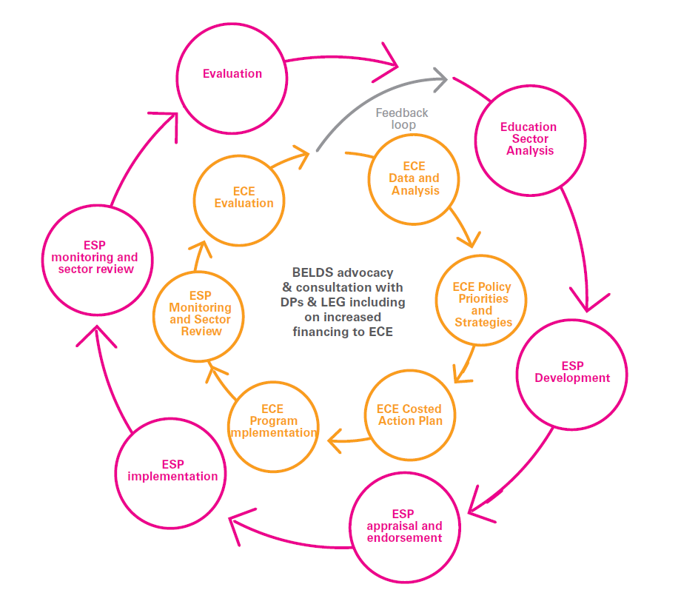
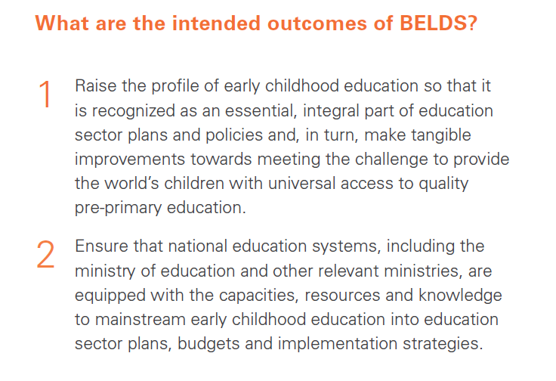
BELDS Overview

Slide 5
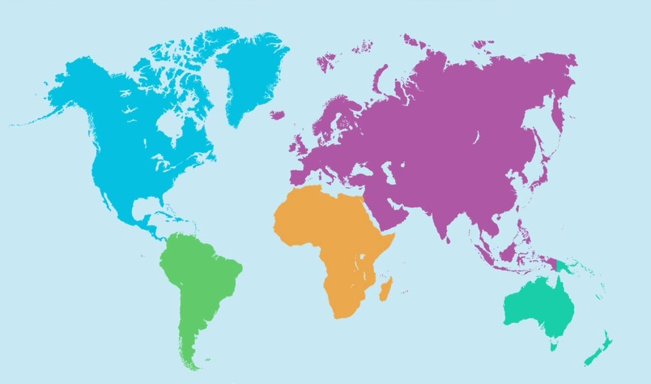
In-country capacity development
Ghana: KG policy directive; KG costed action plan; M&E Framework
Kyrgyzstan: ECE strategy and action plan development mainstreamed into broader ESP;
Capacity building at national and subnational levels
Kyrgyzstan
Sao Tome & Principe: ECE strategy and action plan included in Policy Chart; ECE finance advocacy; Capacity building on key areas of the subsector
Ghana
Sao Tome & Principe
Lesotho
Lesotho: Costed scale up strategy for reception classes; ESP and costed 5-year action plan; ECE data and analysis integrated into ESA

Slide 6
GHANA EDUCATION SERVICE
Republic of Ghana
Ghana’s Story: Establishing the ECE Policy Framework

Slide 7
Background to the ECE Policy – The Education Sector Analysis 2018:
High KG Pupil Classroom Ratio (53:1) compared to an average of 35:1 for Primary and JHS
65% of Trained KG teachers BUT very few teachers have qualification and specialization in ECE/ECCD
Poor Primary school readiness due to poor foundation at ECE level (EGRA /EGMA results) and non attendance of KG
Limited range and use of ECE data in the existing monitoring regime
Weak Family and Community engagement in ECE
Non-existence of ECE policy to provide direction and ensure uniformity and compliance
Notes:
Can add to this if needed for SL

Slide 8
STEPS TAKEN AFTER ESA AND ESP
ESA provided the ground and basis for developing the ESP 2018 -2030
ECE was a Key area that has been mainstreamed into the ESP 2018-2030
Establishment of ECE Technical Working Group
Diagnostic Analysis and validation of the state of ECE sub-sector in Ghana with support from Technical Group and Initial Stakeholders
Identification of 5 Action Areas of focus of the ECE Policy
Organization of a broader stakeholder engagement and workshop around the ECE Policy Action Areas
Firming of Action/Areas for the Policy Framework and initial draft Policy by Technical Group
Quality assurance of the draft with review from external group
A dedicated ECE stakeholder engagement at the National Education Week (NEW)2019

Slide 9
ECE Policy Framework and Implementation Plan
Development of ECE goals, objectives and Strategies
Prioritization of Strategies by Technical working group
Linkage of Strategies to the ESP 2018-30/ESMTDP 2018-21
Development of Activities linked to the strategies
Development of Indicators for Goals, Objectives, Strategies and Activities linked to MTP and ESP
Costing of the Activities ongoing
Notes:
Refer to the cheat sheet handout
Practical tool which very systematically supports countries an gov’ts analyze the sub-sectoral strengths and challenges and leads to the development of a coherent action plan that can in turn be integrated into or imform Education sector plans, costing models, donor proposals, partner investment and more
This is turning out to be a very relevant and timely strategy for UNICEF given our comparative advantega ad ability to convene partners in support of Gov’ts

Slide 10
Participation in MOOC on Mainstreaming
Early Childhood Education into
Education Sector Planning
The members of the national TWG registered and participated in the MOOC which was organized by UNESCO, IIEP, GPE and UNICEF.
Others not on the TWG were selected for engagement as part of members for the validation.
Members deepened their understanding of ECE issues and used the what was being practiced through the ECE development process as key strategies needed to be employed through the ECE Policy development. E.g. how to campaign for support for ECE,
Notes:
Refer to the cheat sheet handout
Practical tool which very systematically supports countries an gov’ts analyze the sub-sectoral strengths and challenges and leads to the development of a coherent action plan that can in turn be integrated into or imform Education sector plans, costing models, donor proposals, partner investment and more
This is turning out to be a very relevant and timely strategy for UNICEF given our comparative advantega ad ability to convene partners in support of Gov’ts

Slide 11
Validation of the ECE Policy
National broader stakeholder validation of the draft ECE policy (carried out in three zones)
The TWG engaged stakeholder representation groups and individuals across the Northern, Middle and Southern Zones of the Country.
To enrich strategies/activities developed aimed at ensuring a robust ECE Policy Framework
Participants not on the TWG who completed the ECE MOOC also had practical experience working with the five action areas.
Notes:
Refer to the cheat sheet handout
Practical tool which very systematically supports countries an gov’ts analyze the sub-sectoral strengths and challenges and leads to the development of a coherent action plan that can in turn be integrated into or imform Education sector plans, costing models, donor proposals, partner investment and more
This is turning out to be a very relevant and timely strategy for UNICEF given our comparative advantega ad ability to convene partners in support of Gov’ts

Slide 12
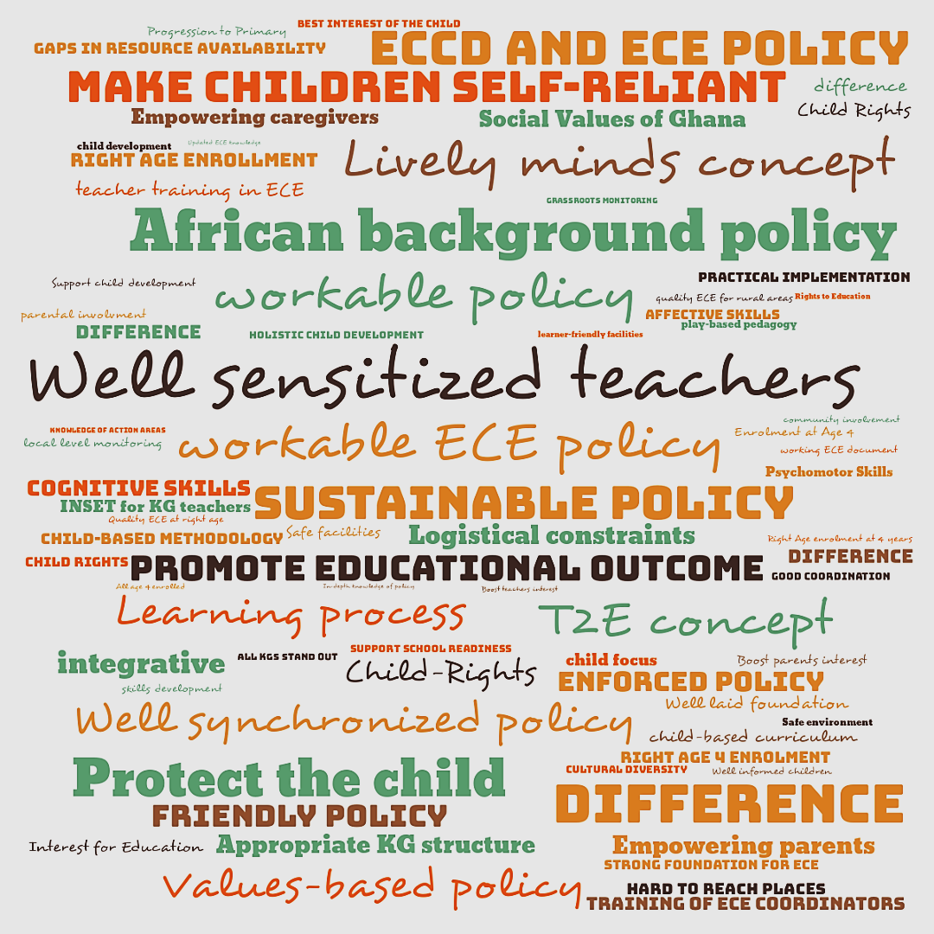
Expectations for ECE in Ghana
Northern Zone
Notes:
Refer to the cheat sheet handout
Practical tool which very systematically supports countries an gov’ts analyze the sub-sectoral strengths and challenges and leads to the development of a coherent action plan that can in turn be integrated into or imform Education sector plans, costing models, donor proposals, partner investment and more
This is turning out to be a very relevant and timely strategy for UNICEF given our comparative advantega ad ability to convene partners in support of Gov’ts

Slide 13
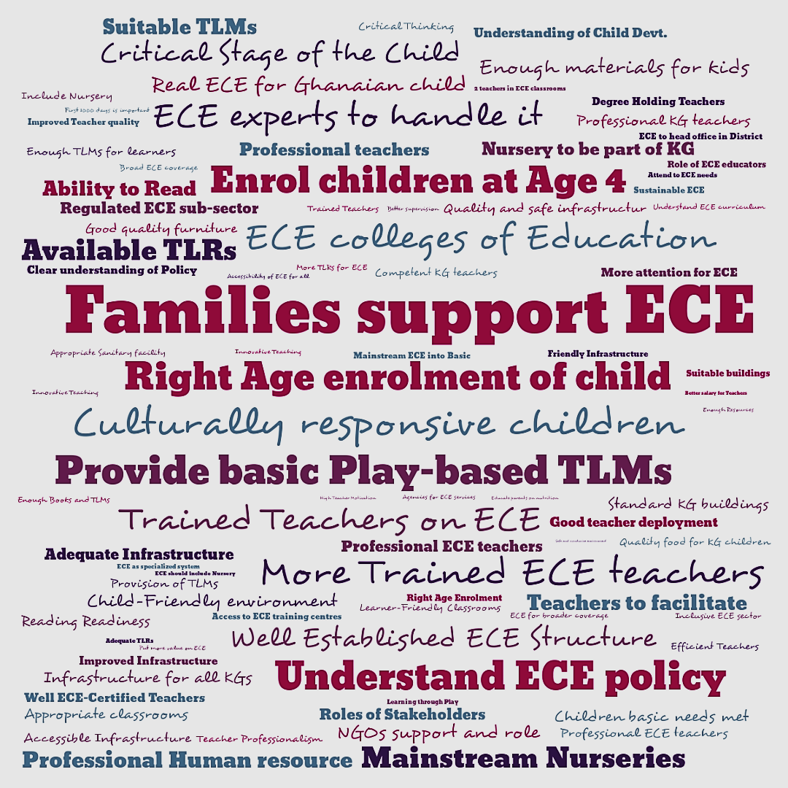
Expectations for ECE in Ghana
Middle Zone
Notes:
Refer to the cheat sheet handout
Practical tool which very systematically supports countries an gov’ts analyze the sub-sectoral strengths and challenges and leads to the development of a coherent action plan that can in turn be integrated into or imform Education sector plans, costing models, donor proposals, partner investment and more
This is turning out to be a very relevant and timely strategy for UNICEF given our comparative advantega ad ability to convene partners in support of Gov’ts

Slide 14
LESSONS LEARNED IN THE PROCESS OF ECE POLICY FRAMEWORK DEVELOPMENT
The process takes time – political commitment and buy-in from leadership and work of the TWG were key factors to make progress
Leadership and coordination of the TWG was critical for sustaining interest and moving forward
The ECE TWG was critical to promote ownership, maintain momentum and sustain engagement and perspectives from wide range of stakeholders – TWG as advocates and champions of ECE
The uniqueness of the ECE subsector was evident and highlighted in the process
Focus on the ECE subsector needs to be aligned with other subsectors and with broader Education sector priorities and strategies
Contribution of BELDS approach: process; technical support; advocacy; MOOC; participation in exchanges

Slide 15
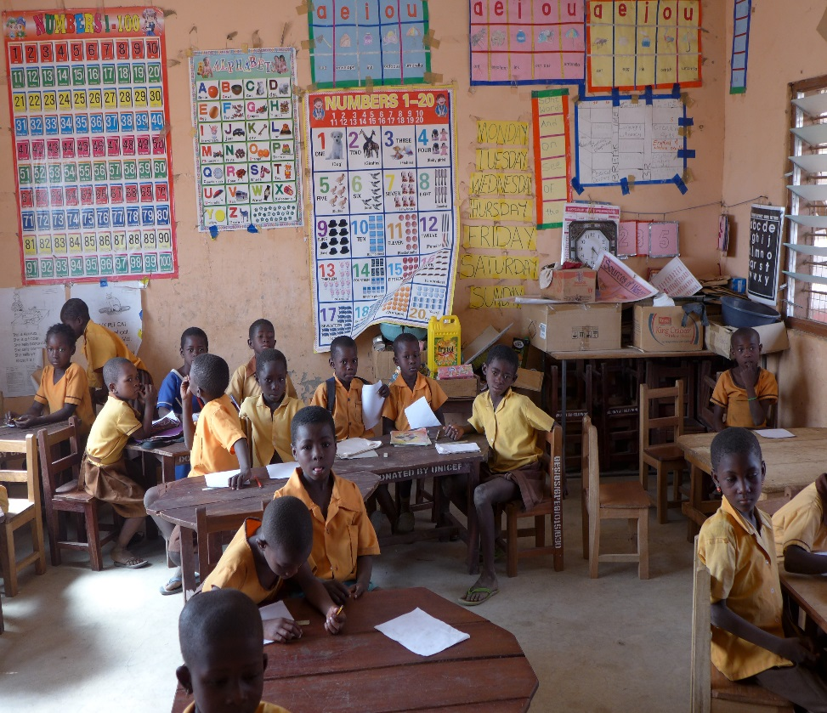
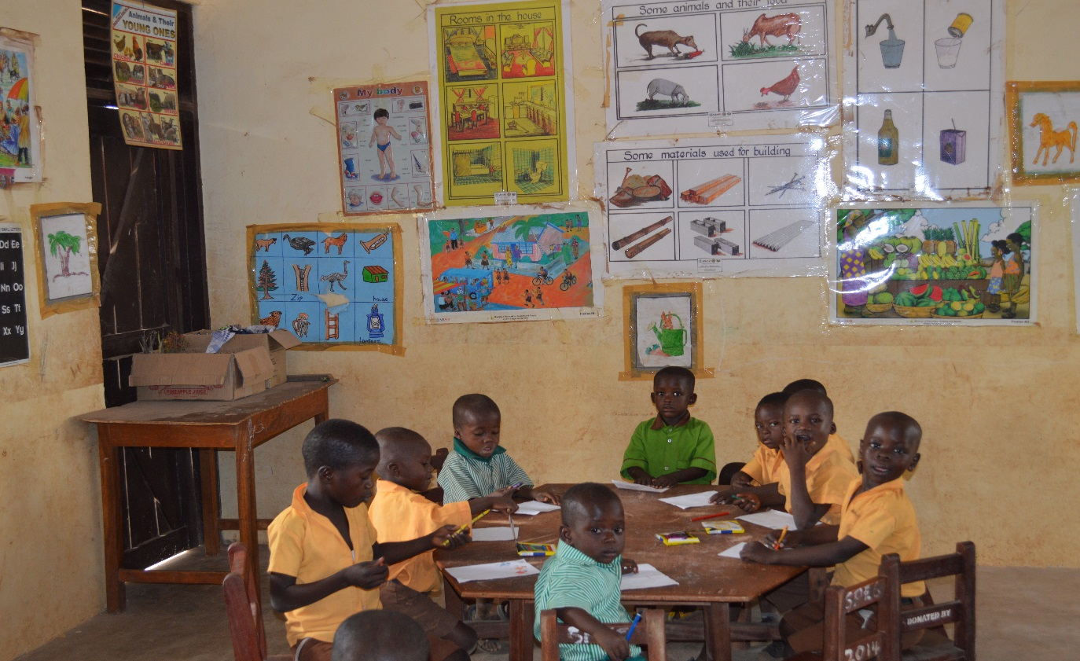
GHANA EDUCATION SERVICE
© UNICEF/PFPG2015-2253/Lynch
THANK YOU

Slide 16
Better Early Learning and Development at Scale (BELDS)
Webinar: Strengthening ECE in Education Sector Analyses and Plans
February 27th, 2020

Slide 17
Context
Favorable educational context
Approval of Law for Basic Education(2018)
Compulsory and free education guaranteed for children aged 4 to 5 years;
Significant increase of pre-primary rate (2014- 66.1% / 2017-18 -78.6%)

Slide 18
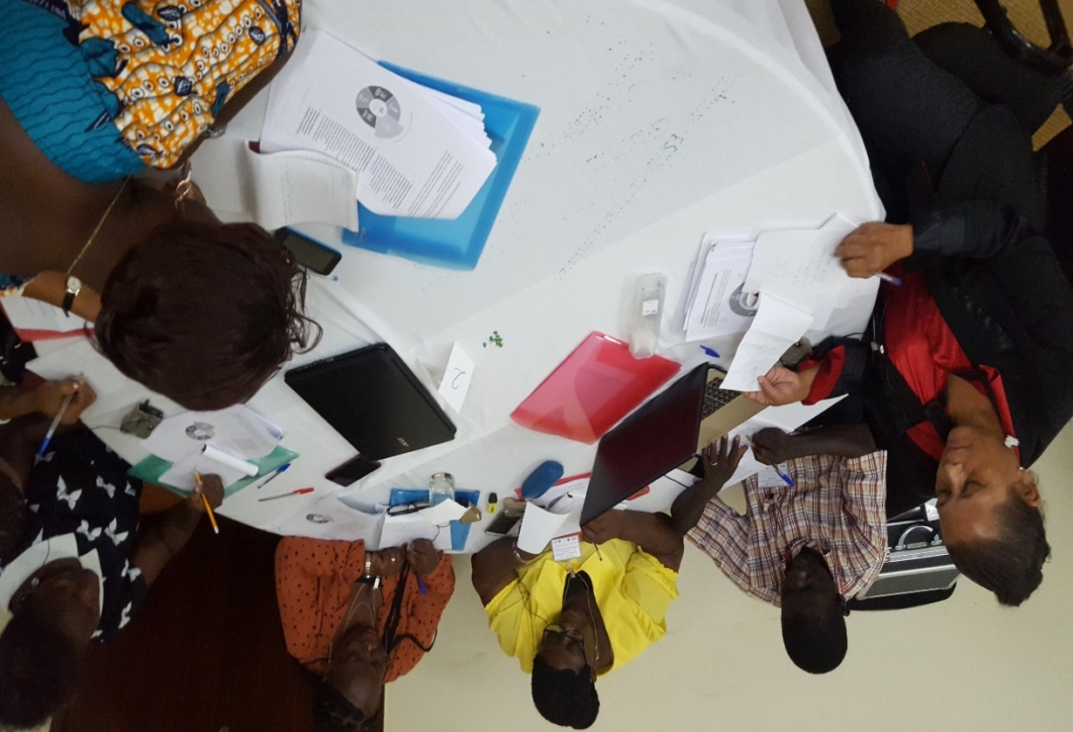
Sao Tome e Principe's Story: ECE Integrated into the Education Policy Chart and Action Plan
What was the development process of the Education Policy Chart and how was ECE tackled in this process?
The process of developing the education policy chart began with a sectorial analysis (CSR - 2018), which prompted thinking about the new Education Policy Chart;
Technical working groups involving all the directorates and partners were created with a view to identifying strategic actions (CPE 2019-2023);
ECE was considered to be a government priority since it was being constructed on the basis of the positive outcomes indicated by the situation analysis;
It was necessary to capitalize on the positive results by adopting a more holistic and coherent approach to pre-primary education as forming an integral part of Sao Tomé’s education system.
Notes:
Composition of the technical groups: Ministry of Finance, central entity of the MEES (DAF, DAE, DPIE, DEB, ISEC, regional educational delegates, authorities, private sector, NGOs, parent associations, supervisors, inspectors, school administrators, educators, etc.)

Slide 19
Sao Tome e Principe's Story: ECE Integrated into the Education Policy Chart and Action Plan 2019-2023
The holistic and inclusive vision of all the stakeholders (partners and the entire education community) was achieved as the result of various joint and sequential exercises that helped define the consensuses, expectations, priorities, and capacities regarding two key strategic objectives:
Objective 1: By 2023, scale up compulsory, inclusive, equitable and free universal access by Saotomean children (4-5 years old) to pre-primary education;
Objective 2: By 2023, enable Saotomean children to develop the basic skills to prepare them for life and the next level of education.

Slide 20
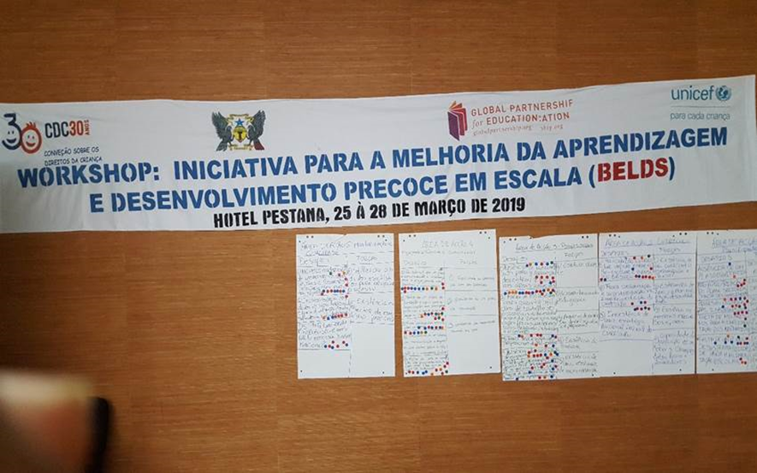
Sao Tome e Principe's Story: ECE Integrated into the Education Policy Chart and Action Plan
(Continued)
The BELDS initiative comes at a strategic moment, enabling a review to be carried out of the Policy Chart and Action Plan by using diagnostic tools that have allowed the realignment of strategies and activities in 6 key areas:
Planning and effective use of resources;
Curriculum;
Engagement of family and community;
Pre-primary school teachers and other staff;
Monitoring, Regulation, and Quality Assurance;
Supportive environment.

Slide 21
Sao Tome e Principe's Story: ECE Integrated into the Education Policy Chart and Action Plan
Challenges:
Inadequate budget forecast;
Ineffective curriculum coordination between pre-primary and basic education;
Absence of a Communication and Strategy Plan to engage families and the community;
Lack of coordination of multisectorial programs dealing with vulnerable families;
Lack of a strategy to guarantee the physical working conditions of pre-primary teachers in school premises;
Lack of a decentralized teacher training mechanism in remote areas.

Slide 22
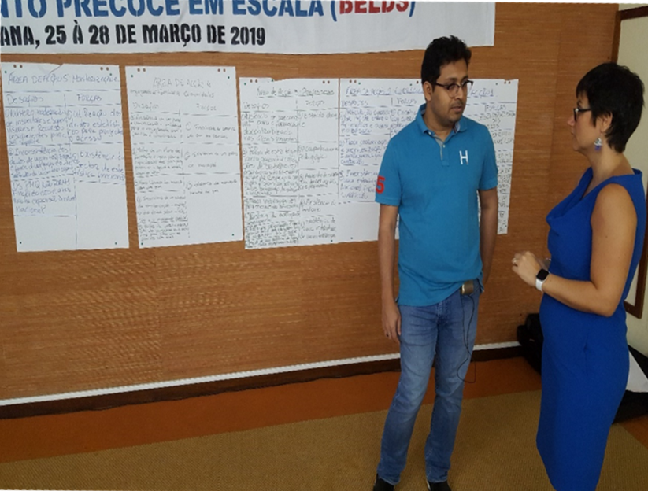
MEES-CPE ACTION PLAN
The Policy Chart and the Strategic Plan, revised and reformulated following the diagnostic exercise, ensured that consideration was given to:
1. Creating a favorable environment for the governance of pre-school structures by employing strategic actions through:
Revision and regulation of the legal and institutional framework;
Definition and application of an institutional framework for pre-primary education;
Introduction of a plan for strengthening pre-primary capacity; and
Creation of a communication and awareness-raising framework;
2. Establishing the necessary conditions for improving the quality of the services through the:
Adoption of quality standards for strengthening the quality assurance processes of the services; and
Implementation of the pre-primary school curriculum.

Slide 23
SHORT-TERM ACTIONS BELDS- CPE-PSE
Integrate the pre-primary subsector into the National Education Council and the coordination and monitoring mechanisms of the Policy Chart
Strengthen the capacity of Ministry of Education personnel through study visits to manage and expand Infant Education in STP
Reorganize the districts and zones of the pre-primary coordinators responsible for monitoring the implementation of pre-primary activities
Organize and define mechanisms to engage parents, educators, and communities
Ensure minimum quality indicators to guarantee the proper functioning of early childhood education
Carry out the Joint Sector Review (JSR)

Slide 24
THANKS
OBRIGADA
MERCI
Sector Analyses and Plans: OBRIGADA Better Early Learning and Development at Scale (BELDS)
Webinar:Strengthening ECE in Education

Slide 25
Moderated Q&A
Notes:
What would you do differently if you could "do it all over again"?
What are upcoming plans in your country context now that ECE is strengthened in the Education Sector Plan?
What capacity building plans are in place to strengthen the linkages between planning and implementation?

Slide 26
Next BELDS Webinar:
Thursday, 23 April 2020 at 8:30am EST – featuring Kyrgyzstan and Lesotho
Learn more about BELDS:
https://www.globalpartnership.org/content/better-early-learning-and-development-scale-belds-flyer
BELDS Lesotho Blog:
https://www.globalpartnership.org/blog/scaling-early-education-young-children-lesotho
BELDS Ghana Blog:
https://www.globalpartnership.org/blog/ready-learn-ghana-frontrunner-universal-pre-primary-education

